Slide 1

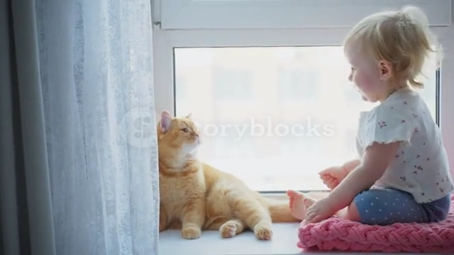
Thank you for joining us today!
Take a moment to respond to this question in the chat box….
Think Starter
Look at the picture:
How would you respond to keep the child curious?
Notes:
(2 min)
Welcome everyone—I'm so glad you're here. Today is really about honoring what you already do well and giving you language and strategies to do it even more intentionally.
Keeping Curiosity Alive
As you look at this image, notice what the child is already doing.
Research on early learning tells us that learning is strongest when it starts with the child’s interest (National Association for the Education of Young Children). When we respond by naming what we see, wondering aloud, or inviting exploration, we keep curiosity alive instead of shutting it down.
There’s no “perfect” response—what matters is that the response invites the child to keep thinking.

Slide 2
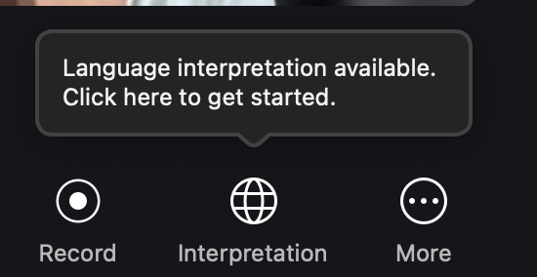
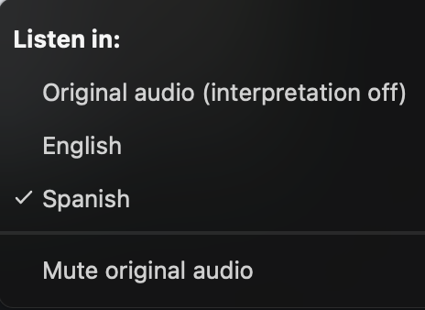
¡Bienvenido! Escuchar en Español
Desde Ordenador (Computer)
En los controles de su reunión web, haga clic en Interpretation (Interpretación).
  In your meeting/webinar controls, click Interpretation.
Haga clic en Español.
  Click Spanish.
Para escuchar solo el idioma interpretado, haga clic en Mute Original Audio (Silenciar audio original).
  To hear the interpreted language only, click Mute Original Audio.
Notas: Debe unirse al audio de la reunión a través del audio/VoIP de su computadora. No puede escuchar la interpretación de un idioma si usa las funciones de audio de marcación o llamada telefónica.
  Notes: You must join the meeting audio through your computer audio/VoIP. You cannot listen to language interpretation if you use the dial-in or call me phone audio features.
Por Teléfono (Phone)
En los controles de reunión, haga clic en los puntos suspensivos.
  In your meeting controls, tap the ellipses.
Toque Language interpretation (Interpretación de idioma). Haga clic en Español.
  Tap Language Interpretation. Click Spanish.
Para escuchar solo el idioma interpretado, toque el botón para silenciar el audio original
  Tap the toggle to Mute Original Audio.
Haga clic en Done (Listo).
  Click Done.
Notes:
(1 min)
We want today’s conversation to be accessible to everyone, so here are quick reminders about our Spanish interpretation options.

Slide 3
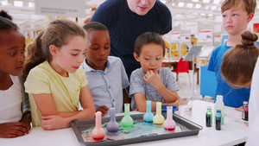

From Curiosity to Critical Thinking: How Facilitating Learning Grows into Deep Thinking
March 26, 2026 @1pm
Dr. Tara L. Scott
Virginia Early Childhood Consultation (VECC)
Notes:
(1 min)
Children are born curious. They don’t need us to add curiosity—they need us to protect it, notice it, and stretch it. Our role as educators is not to give answers quickly, but to create moments where children wonder, try, rethink, and try again. This session will show how those small, everyday interactions—your words, pauses, and questions—build the foundation for lifelong thinking skills. Let’s get started!

Slide 4
Session Objectives
®
Educators will:
Identify children’s learning experiences, from curiosity in infancy to critical thinking through CLASS dimensions of Infant Facilitated Exploration, Toddler Facilitation of Learning and Development, and PreK Concept Development.
Understand developmentally appropriate strategies to facilitate learning and thinking in the infant, toddler, and PreK classrooms.
Apply at least two open-ended questions or facilitation strategies
to support children’s curiosity and critical thinking in daily practices.
Notes:
(1 min)
These objectives reflect a developmental progression. (Read the bold objectives)
Curiosity in infancy becomes exploration in toddlerhood, which grows into reasoning and analysis in PreK. CLASS helps us see this progression clearly—and gives us a shared language for supporting it.
By the end of today, you’ll leave with strategies you can use tomorrow, not someday.

Slide 5

Build Your Toolkit From This Session
CLASS Practices/Scenarios/Videos
Developmentally Appropriate Strategies
Ready-to-Use Resources
Short Survey
1 hr. Certificate
Notes:
(1 min)
Everything today is meant to be practical.
You’ll hear strategies that work during routines, play, transitions—real moments, not extra lessons.
And remember, small shifts in interaction can lead to big changes in thinking.

Slide 6
Why Talk Matters!
Across all age groups, effective educators:
Follow children’s curiosity
Ask thoughtful questions
Encourage exploration and thinking
Support learning in the moment
Resources to Support Your CLASS Journey
Teachstone: Vlog: Teacher Sensitivity and Facilitated Exploration with Infants
Teachstone: 3 Overlooked Opportunities for Facilitation of Learning and Development
Teachstone: PreK: Concept Development: Creating
ECE Resource Hub (UVA-CASTL): Core Skill: Supporting Children’s Thinking Skills with Activities, Videos, etc.
Using CLASS® Scores to Guide Improvement/Spanish
(VDOE/VQB5)(For Site/Program Leaders)
CLASS® Tool Summaries: Infant /Spanish
Toddler/ Spanish Pre-K/Spanish
Notes:
(2 mins)
(Read slide & share resources for their CLASS journey!
Brain research shows that language and thinking develop together.
Every time you narrate, ask a question, or reflect a child’s thinking, you are literally shaping how their brain organizes information.

Slide 7
CLASS Across the Ages
Age Group | CLASS Dimension | Focus
Infant | Facilitated Exploration (FE) | Sensory Exploration
Toddler | Facilitation of Learning & Development (FLD) | Guided Learning & Persistence
PreK | Concept Development (CD) | Higher-Order Thinking

Slide 8
What is Facilitation of Learning & Development (FLD) & Facilitated Exploration (FE)?
Toddler - Facilitation of Learning & Development (FLD):
Taking an active role in classroom activities and providing intentional support that guides children’s experiences.
Infant – Facilitated Exploration (FE)
Watching infants to see what they are interested in and building on or adjusting their experiences to provide opportunities and keep them engaged.
Notes:
1 min
For infants, Facilitated Exploration means watching closely and responding with intention.
For toddlers, Facilitation of Learning and Development means taking an active role—helping children persist, problem-solve, and stay engaged.
You are a learning partner.

Slide 9
What is Concept Development (CD)?
PreK – Concept Development
How teachers facilitate children’s broader understanding of concepts and ideas, rather than concentrating on rote instruction and recall of facts.
Notes:
1 min
Concept Development moves beyond right answers.
It’s about helping children explain why, compare ideas, predict outcomes, and connect learning to real life.
Research shows that children who experience higher levels of concept development demonstrate stronger executive function and later academic success.

Slide 10
What Do the CLASS Numbers Mean?
CLASS® Ranges (scores) | What it means
Low range (1-2) | Observed rarely, at a lower quality
Mid range (3-5) | Observed sometimes, varying quality, with some children
High range (6-7) | Observed consistently, high quality, across children
Notes:
(1 min)
“These CLASS numbers help us see trends, not judgments. They tell us where children need more support and where teachers can use more tools.
Think of CLASS as a mirror — not a report card. Today’s strategies help bring those numbers to life in your everyday interactions.”
CLASS® scores range from 1 to 7, showing how often and how well effective interactions are observed in classrooms.
A score in the Low Range (1–2) means the behavior or interaction is observed rarely and at a lower quality — it might happen occasionally but not in a meaningful or consistent way.
A Mid Range (3–5) score shows the behavior is seen sometimes and with varying quality — teachers demonstrate it with some children or during certain moments, but not consistently.
The High Range (6–7) reflects consistent, high-quality interactions across children and throughout the observation — this is where strong, intentional teaching and caregiving are most visible.
Here is a reminder: CLASS® scores don’t measure perfection—they show patterns of interactions and help identify where coaching and support can make the greatest impact.

Slide 11
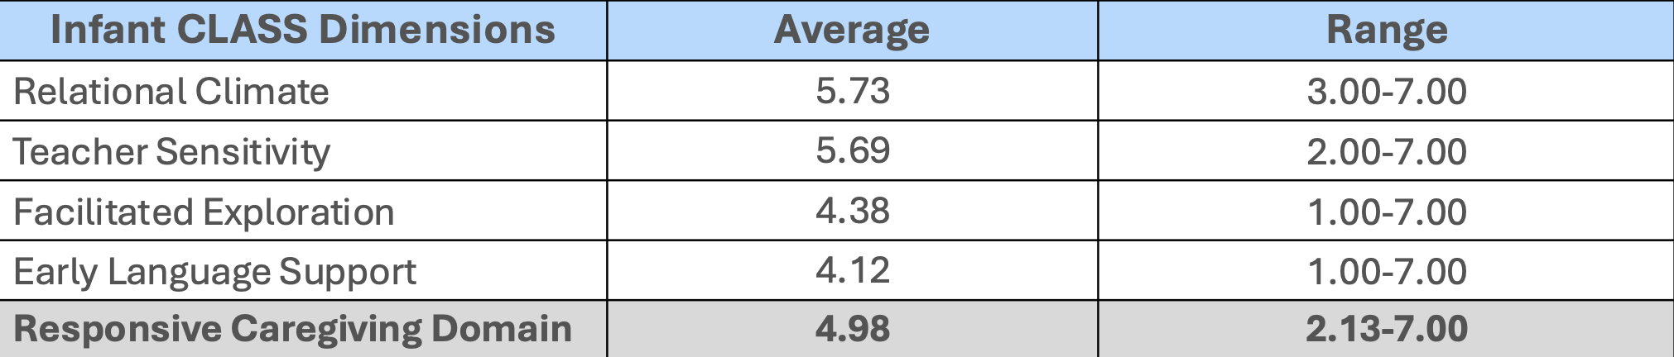
What Does CLASS® Data Tell Us About Virginia’s Infant Classrooms?
Data are pulled from VDOE’s publicly-available data of VQB5 CLASS® Data Averages from 2024-25
Notes:
(1 min)

Slide 12
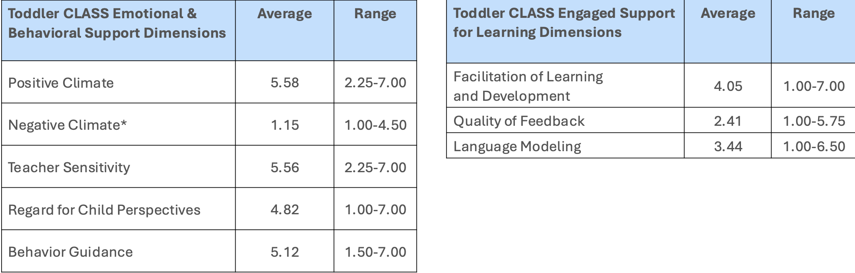
What Does CLASS® Data Tell Us About Virginia’s Toddler Classrooms?
Data are pulled from VDOE’s publicly-available data of VQB5 CLASS® Data Averages from 2024-25
Notes:
(1 min)

Slide 13
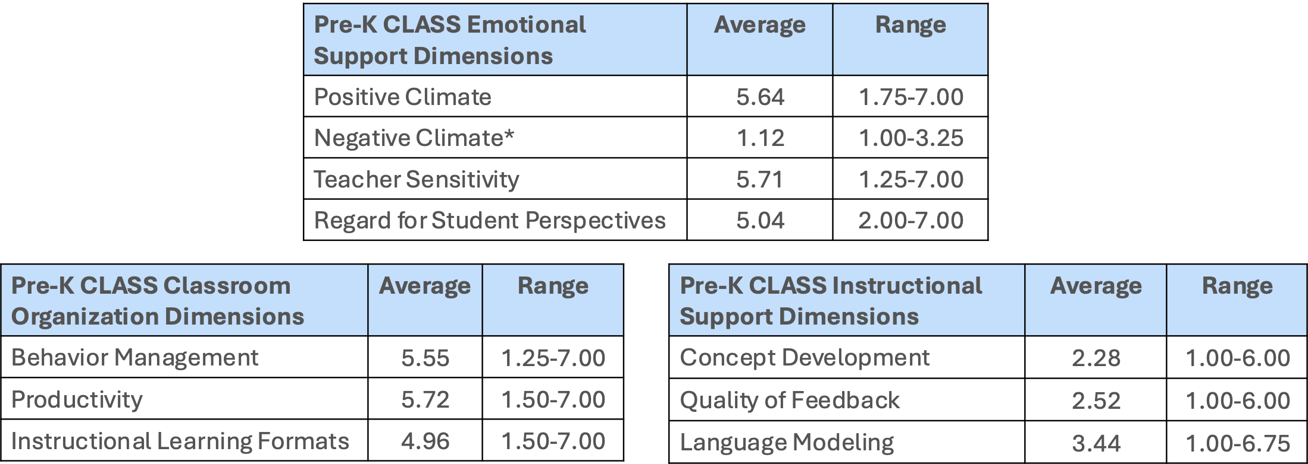
What Does CLASS® Data Tell Us About Virginia’s PreK Classrooms?
Data are pulled from VDOE’s publicly-available data of VQB5 CLASS® Data Averages from 2024-25
Notes:
(1 min)

Slide 14

Let’s Unpack!
From Curiosity to Critical Thinking: How Facilitating Learning Grows into Deep Thinking
Notes:
(1 min)

Slide 15
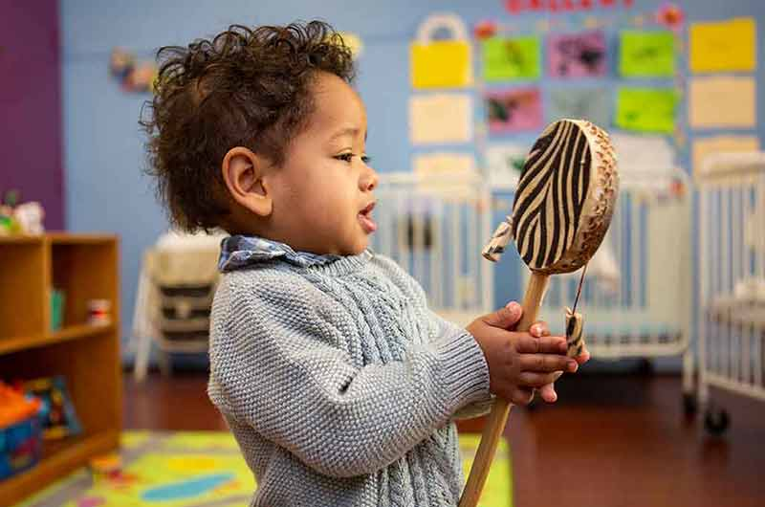
Infants
Dimension:
Facilitated Exploration (FE)
Notes:
(1 min)
Infants learn through their senses.
When you join their exploration—by naming, reacting with enthusiasm, or simply staying present—you help them build attention, curiosity, and confidence.
Even brief moments of shared attention matter.

Slide 16
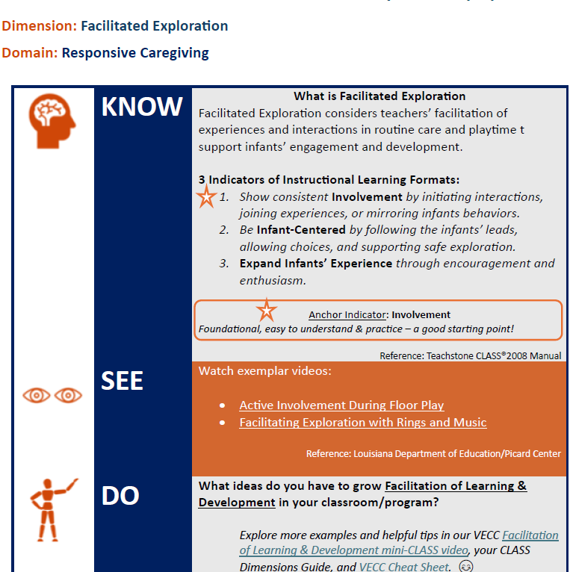
Infant Facilitated Exploration Know-See-Do Strategies (Spanish)
Educators:
Show consistent involvement by initiating conversations and joining experiences
Follow infants’ leads, allow choices, and support safe exploration
Expand infants’ experience through encouragement and enthusiasm
Notes:
3 min
(Read KSD 1-pager)

Slide 17
Want More Infant Classroom Strategies?
Educators can:
Offer safe, sensory-rich materials
Allow infants time to explore freely
Narrate what infants are doing
Respond with warmth and curiosity
Examples:
“ You’re touching the soft ball.”
“ I see you shaking it—listen to that sound!”
Notes:
(1 min)
Read slide
Add: Think about slowing down.
When infants are given time to explore without interruption, their brains stay engaged longer.
Your calm narration—“You’re touching… you’re noticing…”—helps them organize experience into meaning.

Slide 18
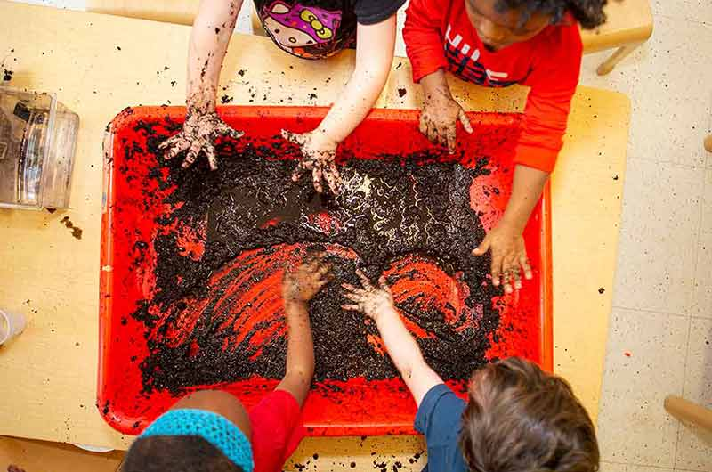
Infant- Facilitated Exploration (FE)
Scenario:
An infant reaches for a textured toy and turns it over.
Educator’s Response:
“You found the bumpy side. You’re looking so closely. What does it feel like in your hands?”
Notes:
(2 mins)
Read scenario- modeling the tone as well.
Notice how the educator doesn’t quiz or rush.
The language is descriptive and invitational.
This kind of response supports early cognitive flexibility and sensory processing—key foundations for later problem-solving.

Slide 19
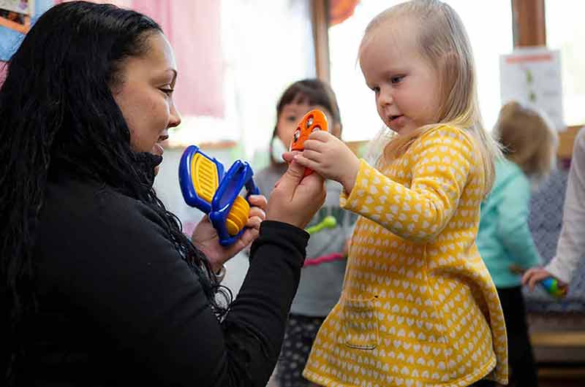
Toddlers
Dimension:
Facilitation of Learning and Development (FLD)
Notes:
1 min.
Toddlers are natural problem-solvers.
When we say, “What could you try next?” we communicate trust in their thinking.
This supports persistence and self-regulation—skills strongly linked to later school success.

Slide 20
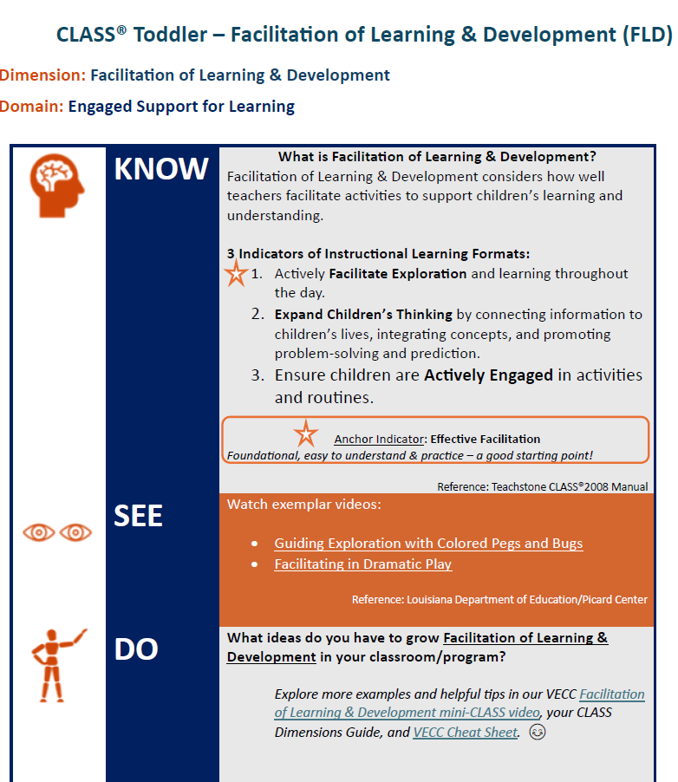
Toddler Facilitation of Learning & Development (FLD)
Know-See-Do Strategies (Spanish)
Educators:
Actively facilitate exploration and learning throughout the day
Expand children’s thinking by connecting to children’s lives
Ensure all children are actively engaged in activities and routines
Notes:
(2 mins)
Read slide

Slide 21
Here’s More---Toddler Classroom Strategies
Educators can:
Ask “what” and “how” questions
Encourage children to try again
Model thinking out loud
Connect actions to language
Examples:
“What could you try next?”
“You’re working hard on that!”
Notes:
(1 min)
Read the strategies slowly.
What” and “how” questions invite thinking without pressure.
Modeling your thinking aloud helps children learn how to approach challenges, not just solve them.

Slide 22


Curiosity Moments
Using the chat box to provide your response to:
What’s a moment in your day when children are already curious—and how could you engage them more?
Notes:
(2 mins)
Curiosity is already happening all day.
Our goal isn’t to create more activities—it’s to notice the thinking already there and respond in ways that stretch it just a bit further.

Slide 23

Toddler- Facilitation of Learning and Development (FLD)
Scenario:
A toddler is trying to open a container with a tight lid and pauses, looking at the teacher.
Educator’s Response:
“You’re working hard to open that container. It’s not opening yet. What could you try next?”
Notes:
(2 mins)
Read the scenario using an engaging tone. (Look at the picture)
This response honors effort instead of rescuing.
Research shows that when adults wait and prompt rather than intervene, children develop stronger problem-solving confidence.

Slide 24
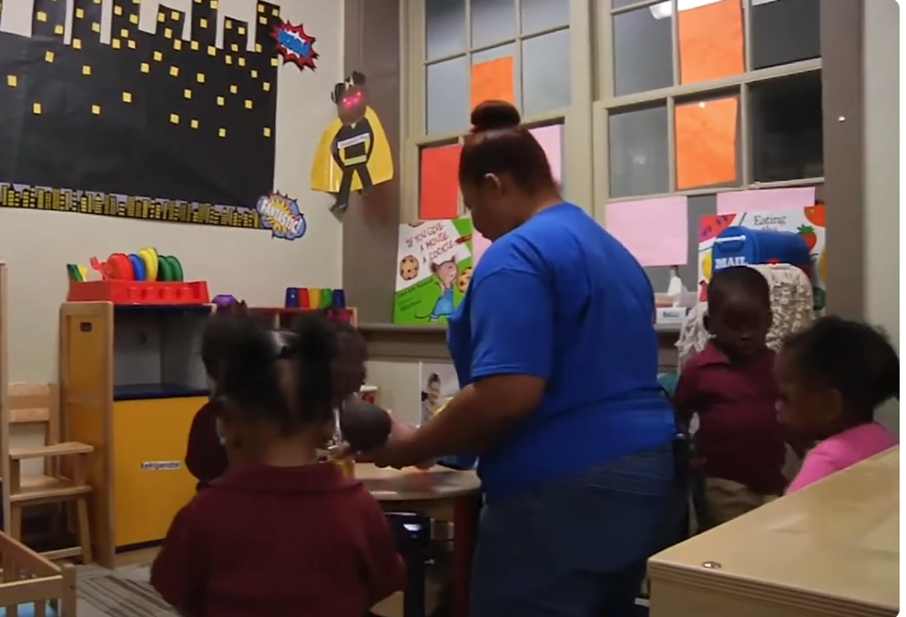
Toddler (Facilitation of Learning and Development) Video
Related Behavior Markers: Infant (Facilitated Exploration)
Facilitating in Dramatic Play
Notes:
(3 mins)
In this toddler classroom, the teacher guides the children’s exploration of baby dolls and diapering by asking questions and adding comments as they engage in pretend play.
Did you notice? Active Facilitation - The teacher notices the children are interested in playing with the baby, and she contributes comments to expand the children’s learning. (“Let’s unfasten the straps and let’s see. Uh oh, I think he has a dirty diaper, India.”
Expansion of Cognition - The teacher provides comments that facilitate the children’s thinking skills, such as, “What do you think I should do? You see, it’s dirty. What do you think I should do?” and “What else do I need?”
Children’s Active Engagement-- The children actively participate in the dramatic play area, huddling around the table, and playing with baby dolls and other pretend toys.
During free play, this teacher plays and talks with children in the dramatic play area. The teacher contributes to the activity with comments and ideas so that children’s learning is expanded.

Slide 25
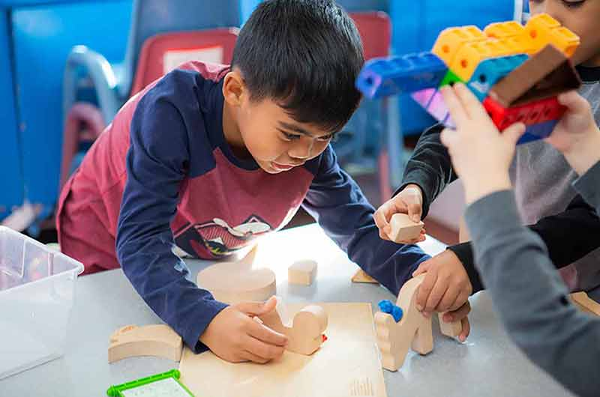
PreK
Dimension:
Concept Development (CD)
Notes:
1 min
Let’s dive deep into PreK… Concept Development!
Concept Development is where curiosity turns into reasoning.
Asking “why” and “what if” helps children compare ideas, test predictions, and explain their thinking.
These are the same skills used in science, math, and reading comprehension later on.

Slide 26
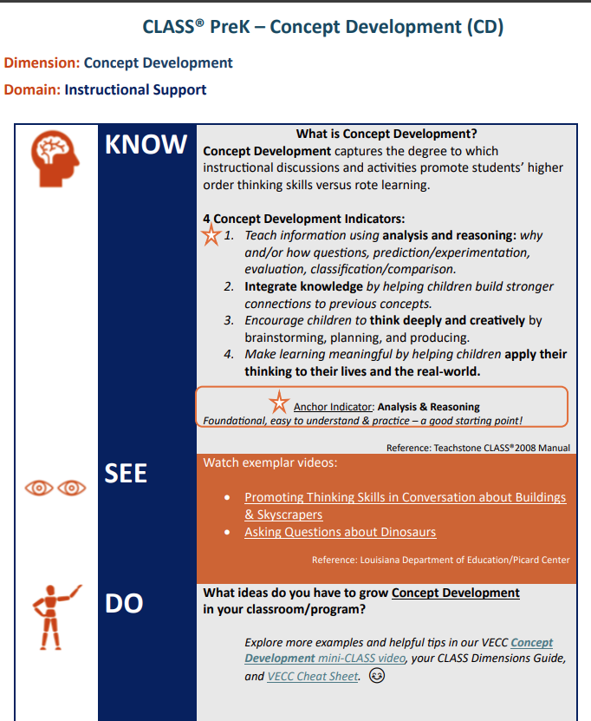
PreK Concept Development (CD) Know-See-Do Strategies (Spanish)
Educators:
Teach information using analysis and reasoning: classification/comparison
Integrate knowledge by helping them build stronger connections to previous concepts
Help children apply their thinking to their lives and the real world
Notes:
(2 mins)
Read slide

Slide 27
Let’s Explore! PreK Classroom Strategies
Educators can:
Encourage multiple solutions
Ask children to explain their own
thinking
Encourage children to make
predictions
Extend learning beyond the
activity
Examples:
“Why do you think that happened?”
“What might happen if we tried it another way?”
Notes:
(1 min)
Encourage multiple solutions.
When children explain their thinking, they deepen understanding—and you gain insight into how they’re learning.

Slide 28
Stretching Thinking
Using the Chat Box to provide your response to:
Think of a recent activity. How could you stretch children’s thinking by asking “why” or “what if”?
Notes:
(3 mins)
Ex) Here is a soft, round ball. How can we play kickball or basketball? How can we make a basketball goal? What if the ball gets lost in the trees? How would we find it? Let’s plan together!
Even small changes in questioning can shift the level of thinking.
One thoughtful “why” can turn an activity into a learning experience.

Slide 29

PreK – Concept Development (CD)
Scenario:
Children are rolling different objects down a ramp.
Educator’s Prompts:
“Why do you think this one went faster?”
“What could we change to make it go slower?”
“How are these objects the same and different?”
Notes:
(2 mins)
This scenario supports prediction, comparison, and cause-and-effect.
These are higher-order thinking skills—and children are capable of them when we give them the space.

Slide 30
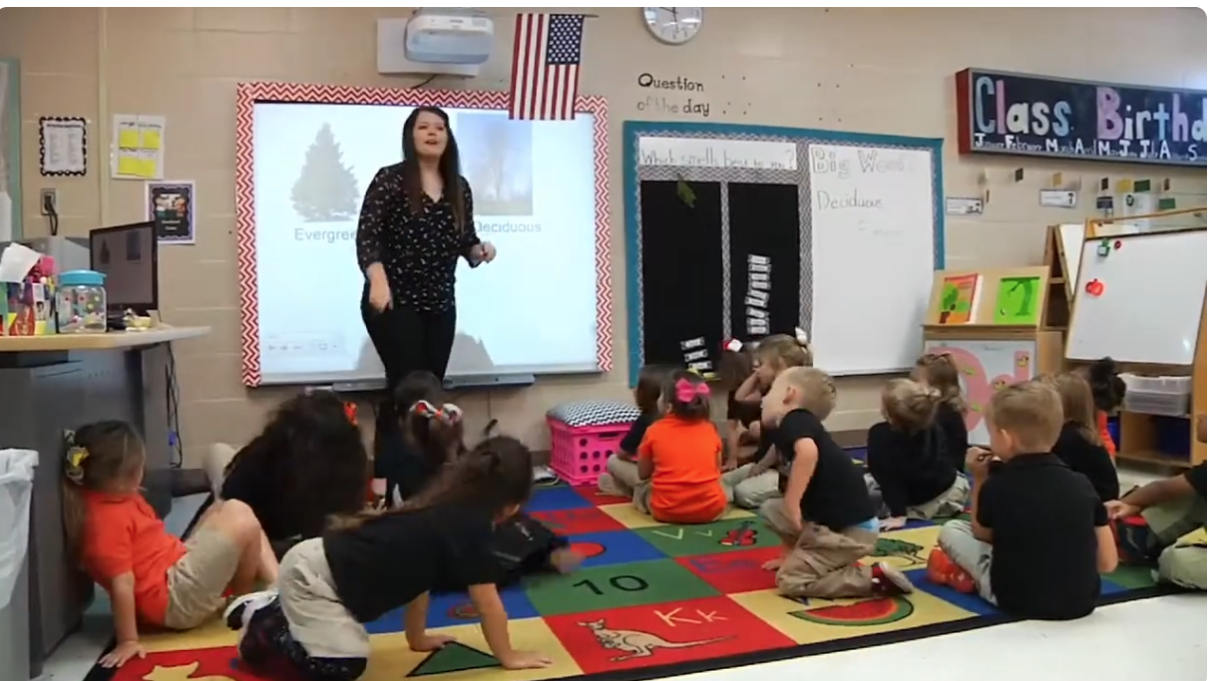
PreK (Concept Development)Video
Students to Think about Trees
Notes:
(3 mins)
What kinds of questions the teacher was asking? Student engagement? Teacher-child interactions?

Slide 31

Concepts + Feedback = Stronger Learning
Concept Development
Promotes deep thinking
Initiated by the teacher to build understanding
Lays the foundation for problem-solving
Quality of Feedback
Extends and reinforces learning
Responds to the child’s ideas or actions
Keeps children engaged in the learning process
Notes:
(2 mins)
Concept Development
Focus: Supporting children’s higher-order thinking and understanding
Initiated by the teacher
Helps children make connections to prior knowledge and the real world
Encourages thinking instead of memorization
Teachers ask questions that invite deep thinking (e.g., “Why might this happen?”)
It’s about the process of learning and understanding concepts.
Quality of Feedback
Focus: Responding in the moment to what children say or do
Happens after a child speaks or acts
Teachers use follow-up questions or specific info
Encourages children to keep thinking and stay engaged
Feedback is timely, specific, and supportive
It helps children expand learning and understanding.

Slide 32
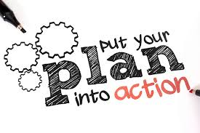
Action Planning
What’s one CLASS strategy you’ll focus on next week to increase facilitation or concept development?
Create a goal
How can you achieve this goal?
--Implementation steps
--Resources
Be consistent with positive interactions
Notes:
(1 min)
Sustainable change happens when we choose one strategy and practice it consistently.
Reflection and repetition lead to growth.
Let’s pause here! What’s one CLASS strategy you’ll focus on next week to increase facilitation or concept development?

Slide 33
Join Us Again in May!
May 7, 2026 @ 1pm– Register Here
From Observation to Transformation: Using Video Reflection to Strengthen Teacher-Child Interactions & Reflective Practice Across All VQB5 Classrooms Through guided video reflection, real classroom scenarios, and data-informed discussion, explore how everyday interactions grow children’s thinking from birth through age five. Infants → Responsive Caregiving | Toddlers → Engaged Support for Learning | Pre-K → Instructional Support
Notes:
(1 min)
Thank you for the thinking you do every day.
Your questions, your pauses, your encouragement—those moments matter more than you may realize.
You are shaping curious thinkers and confident learners.

Slide 34

Thank you!
Please take 3 minutes to share your feedback in the Exit Survey
Plus, we’ll send you:
Slides with resources, and recording within 2 days
You’ll receive a certificate of when you complete the survey

