Slide 1
Early Childhood State Updates for Pre-K
January 8, 2020
Recording Link

Slide 2
Objective and Agenda
This webinar will provide an update on proposed legislation and state funding that will support the expansion and unification of Virginia’s early childhood system.
Overview of Key Updates for 2020
  Award of PDG B-5 Renewal
  Proposed Legislation
  Proposed Budget Funding
Implications for School-based Pre-K Programs
  Planning for 2020-2021
Future Communications and Next Steps
Questions

Slide 3
Define the Opportunity
All Virginia children, regardless of background or zip code, are capable of and deserve to enter kindergarten ready.
Yet 40% of Virginia children do not enter school fully ready with the literacy, math, self-regulation and social skills needed to thrive.
Most concerning is that half of children from economically disadvantaged families are not fully ready.
Virginia ranks 33rd nationally in preschool funding.
75% of Virginia’s early childhood programs that receive public funding do not participate in the state’s voluntary quality measurement system; vulnerable families as well as policymakers, practitioners and community leaders do not have uniform information on quality.
Virginia ranks 37th nationally in early childhood governance.

Slide 4
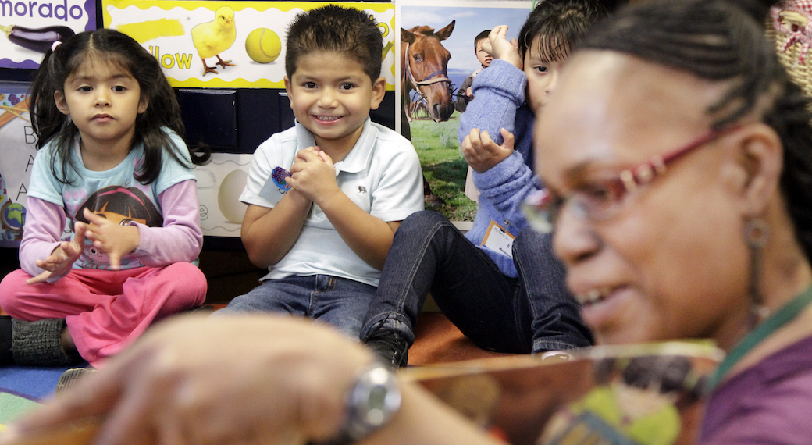

Slide 5
Key Updates for 2020
Virginia will expand and improve the birth-five early childhood system in 2020.
Preschool Development Grant B-5 Renewal
  $33.5 million awarded in December 2019
  Will provide funding to expand community pilots for three years (January 2020-December 2022)
Proposed legislation to establish a unified early birth to five childhood care and education system
  Will be discussed and finalized during 2020 General Assembly Session (January-March 2020)
Proposed $95 million in additional state funding for early childhood
  Budget will be discussed and finalized during 2020 General Assembly Session (January-March 2020)

Slide 6
Preschool Development Grant B-5 Renewal
Virginia has been awarded a PDG B-5 Renewal Grant.
Virginia has received three years of $11 million ($33.5 million overall) to expand the work of the initial 10 pilots.
Additional pilot communities will be invited to join to:
  Build relationships across B-5 early care and education providers,
  Increase access for B-5 children in their community,
  Improve quality through local CLASS observations and professional development, and
  Support family engagement.
Child care educators will be eligible for financial incentives.
What this means for you: VDOE and VECF will soon seek applications for Cohort 2 communities. Cohort 1 pilots will confirm participation for the second year.
Communities are encouraged to begin conversations with partners and to attend forthcoming webinars.

Slide 7
Proposed Early Childhood Legislation
The General Assembly will consider legislation to unify Virginia’s early childhood care and education system.
The Governor’s Administration has proposed legislation to support the unification of Virginia’s birth-five system.
The legislation would:
  Establish a unified public-private early care and education system that is administered by the VDOE and Board of Education;
  Create a uniform quality measurement and improvement system for all early childhood programs that receive public funds;
  Move oversight and licensure of care and education entities to the VDOE and Board;
  Phase in these activities over time.
What this means for you: VDOE will continue to provide updates throughout session. Please read the bill and related documents.

Slide 8
Proposed Funding for Early Childhood in Governor’s Budget
The proposed budget invests an additional $94.8 million over the biennium to transform the early childhood system and increase access for three and four-year-olds:
Enhance VPI and increase access to at-risk 4s via:
  Increased per pupil amount;
  Add-on funds for VPI in mixed-delivery settings;
  Ability to slightly increase class size; and
  Funds to eliminate waitlists through seat reallocation.
Pilot the expansion of two existing programs (VPI and Mixed Delivery Grants) to at-risk 3s in public and private settings.
Expand CLASS observations and professional development funding to all school-based pre-K (ECSE, Title I, and VPI).
Provide incentives to early childhood teachers working for low wages in private settings.
What this means for you: Please review budget language, alert key local stakeholders and begin planning for changes.

Slide 9


Slide 10
Implications for School-based Pre-K Programs in 2020-2021
Several of the proposed budget additions for early childhood funding would have implications for school-based programs beginning in 2020-2021.
Divisions will begin planning for these proposed changes this spring.
  May 15 Spring VPI Application must include plan for additional funding.
  Spring enrollment 2020-2021 school year needs to reflect all plans to serve more at-risk four and three-year-olds.
  Communities must begin coordinating with partners now to support the success of these new initiatives.
The VDOE will continue to provide guidance and support in understanding the implications for their program.

Slide 11
Enhance VPI and increase access for at-risk four-year-olds
Proposed Addition | What this would mean for Divisions
Increase VPI per-pupil amount 10% | Additional funding will be allocated for each VPI seat.
Incent mixed delivery and public-private partnerships | Add-on grant (proposed at $2,500) for each mixed-delivery seat. Must include number of mixed-delivery seats (meeting all existing requirements) in May 15 VPI Plan. - Requires outreach and planning with private providers to begin in early 2020.
Allow for increased ratio for programs meeting benchmarks | VPI Programs that meet or exceed benchmarks set by the Board of Education will be permitted a 1 to 10 ratio (not to exceed 20). Must include intention to use increased ratio in May 15 VPI Plan.
Reduce waitlists through seat redistribution | Indicating a waitlist on the May 15 VPI Plan may result in additional seats, allocated by the end of July.
Waiver for increased local criteria | Seek a waiver to serve more than 15% of slots through local criteria to meet the needs of at risk children in the community.

Slide 12
Pilot programs for at-risk three-year-olds
Proposed Addition | What this would mean for Divisions
Pilot program to expand VPI to serve at-risk three-year-olds | Three-year-olds may be served in same or separate classrooms from four-year-olds. VPI programmatic requirements will be applied. This will be a pilot program. Three-year-olds will not be added to the allocation formula. There will be an additional application to be due on May 15, which indicates how they will: -include stakeholder support and collaboration -track outcomes for students -maximize funds and preserve birth-five options -support inclusive practices
Increase VECF Mixed Delivery Program to include more at-risk three- and four-year-olds | Expanded funding for Mixed Delivery Program (proposed to be $10,000) each year, including three- and four-year-olds. Divisions will have opportunities to partner with private providers in their community. Application and program will be run by VECF, and will be due on August 15.

Slide 13
Expand CLASS Observations and Professional Development
Proposed Addition | What this would mean for Divisions
CLASS Observations | External CLASS observations will continue. Observations will now include all pre-K classrooms (ECSE, Title I, locally funded and VPI). Results from External CLASS inform planning for local professional development and coaching.
Professional Development | Professional Development provided by CASTL will continue. Opportunities for professional development will now include all pre-K classrooms (ECSE, Title I, locally funded and VPI).

Slide 14


Slide 15
How It All Fits Together
Virginia is building the foundation for a more unified system by incorporating similar tools, practices and measures into all these efforts.
Across the efforts discussed today, Virginia is:
Involving both public and private partners that serve infants, toddlers and preschoolers;
Working towards a shared measure of kindergarten readiness as all children are assessed when they enter kindergarten using VKRP;
Using the CLASS tool to measure teacher-child interactions across infant, toddler and preschool classrooms;
Gathering other important data about classroom and teacher quality;
Aligning professional development to meet the individualized needs of teachers and children; and
Using data to inform decisions and drive impact.

Slide 16
Next Steps -
Increasing Access for four-year-olds
As you prepare to serve additional four-year-olds:
January:
Superintendents will receive a letter describing the proposed budget changes as well as current data describing children in need of services.
Divisions calculate number of four-year-olds that could be served next year and begin incorporating in recruitment.
VDOE will begin individual contact with VPI Coordinators.
February:
Continue recruitment and enrollment with revised number of four-year-olds and identification of additional sites or teachers as needed.
VDOE continues individual contact and releases guidance sheets.
March:
Revised VPI Guidelines and assistance for May 15 Application will be released.
Additional webinar focused on May 15 Application will be hosted.

Slide 17
Next Steps -
Pilot Programs for three-year-olds
As you consider piloting programs for three year olds:
January:
Superintendents will receive describing the proposed budget changes, with specific information about the number of qualifying three-year-olds in their region.
Divisions calculate number of three-year-olds they are interested in serving and in which setting.
If participating in the three-year-old pilot, include in recruitment and enrollment efforts.
February:
Continue recruitment and enrollment.
VDOE releases additional guidance as available.
March:
Application to include three-year-olds will be released, along with additional guidance from the VDOE.
More information about VECF Mixed Delivery application will be available this spring.

Slide 18
Next Steps -
Expand CLASS and Professional Development
As you prepare for increased observation and professional development:
January:
Spring external CLASS observations begin.
Divisions use External CLASS Observations (and local CLASS observations where applicable) to provide responsive professional development.
February:
Begin/continue professional development planning for 2020-2021 for all pre-K classrooms, including use of guidance and support from CASTL.
Plan for expanding local CLASS Observations to include (at a minimum) all VPI Classrooms twice a year beginning in 2020-2021.
March:
Divisions consider how to use information gained from External CLASS Observations in finalizing professional development plan for 2020-2021 for all pre-K classrooms.

Slide 19


Slide 20
Additional Resources
Appendix
Resources related to the PDG B-5 Grant
Current VPI Guidelines
  Additional guidance will be posted in the same location and shared electronically as available.
Information about CLASS Observations and resources for professional development

