Slide 1
Asking Children Big Questions – Anytime, Anywhere (Part 1)
Authors Janis Strasser & Lisa Bresson
#3 in a 4-part Webinar Series
January 9, 2020

Slide 2
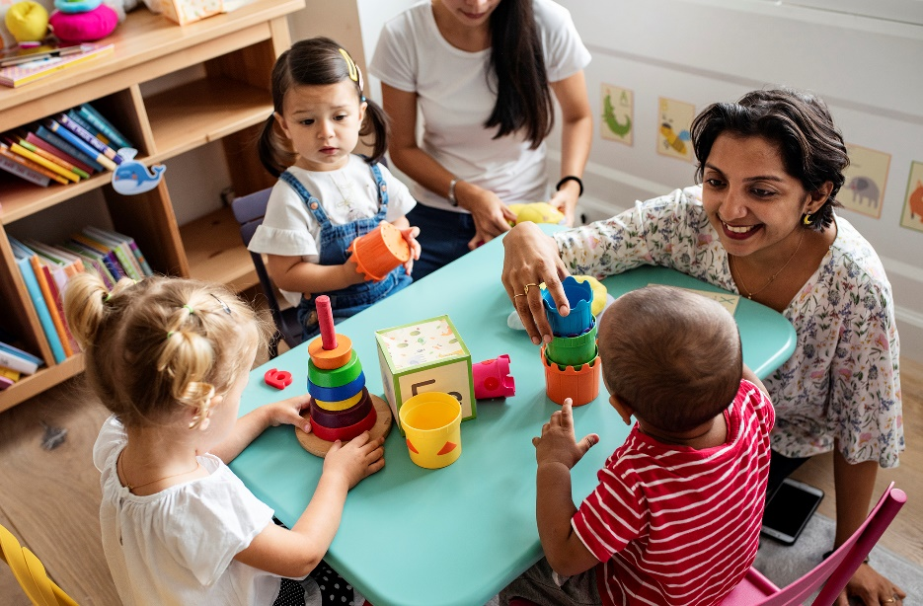
Effective, engaging interactions serve as the foundation for learning in early childhood classrooms.
Measuring teacher-child interactions consistently and using them to provide feedback to teachers lies at the heart of high-quality early childhood instruction.

Slide 3
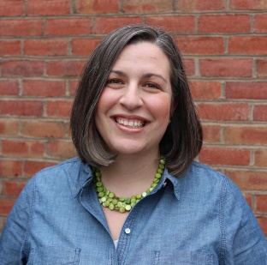
Today’s Presenter
Laura Kassner, Ed.D.
Virginia Department of Education
Coordinator of Preschool Development Grants Laura.Kassner@doe.virginia.gov
Presented with support from the Fairfax County Early Childhood and Norfolk Showcase Teams

Slide 4
Asking Children Big Questions – Anytime, Anywhere (Part 1)
Authors Janis Strasser & Lisa Bresson
#3 in a 4-part Webinar Series
January 9, 2020

Slide 5
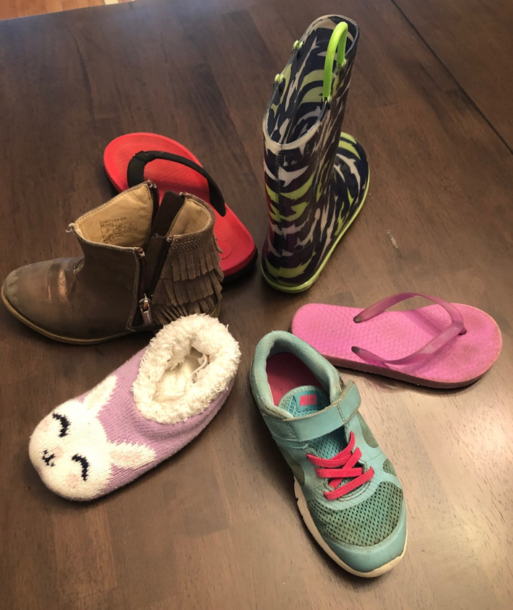
Reflection: Our Shoes Activity
CHAT
The Challenge: Serve and Return
How can you use questioning to promote rich, serve-and-return conversations?
How can you raise the level of questions appropriately during conversations?
How did it go? Tell us in the chat box ☺

Slide 6
Starting with WHY: Research on language-rich environments
Hart & Risley, 1995
30 million word gap by age 3
Between low-income/professional families
NAEYC shares Fernald et al (2013)
Vocabulary gaps by 18 months, larger by 2
Near replication Hart & Risley
(Gilkerson et al, 2017)
More like 4 million word gap,
with variability
Sperry, Sperry & Miller, 2018
SES alone cannot predict
Consider words from caregiver + ambient words in environment
Critique of “gap” deficit thinking. Switch to “word wealth.”
Think of building a foundation and serving students vs. “fixing” them.
Notes:
Let’s ground ourselves in some research on language-rich environments for young children…
In a seminal study in the mid-90s by Hart and Risley, it was estimated that by age 3, there was a 30m word gap between low income and professional families. This study is widely cited to demonstrate the importance of exposing children to language.
On their website, NAEYC shares evidence of vocabulary gaps by 18 months old that increase by age 2.
Then a near replication of the Hart-Risley study calculated the SES language gap to be more like 4 million words, with variability – and a 2018 study said SES alone cannot predict language gaps, because we have to account for words spoken by caregivers to the child as well as the ambient words in their environment. Regardless, even 4 million word gap is significant.
Recent publications critique the model of deficit thinking characterized by the use of the term “gaps.” Instead, they recommend thinking about “word wealth” that some children possess – and how we can better serve students instead of fixing them. All this to say kids don’t come in with the same experiences, and we have to support language development in our classrooms. More excitingly, YOUR work makes a huge difference in building that foundation!
------------------------------------
Citations
- 30 million word gap by age 3 (Hart & Risley, 1995) between low-income and professional families (only 40 families)
Brookings follow-up said # words children hear cannot be predicted by SES alone when you consider words spoken to child from caregiver + AMBIENT words in environment (https://www.brookings.edu/blog/brown-center-chalkboard/2018/06/12/its-time-to-move-beyond-the-word-gap/)
Gap more likely around 4million word gap by age 4
NAEYC says vocabulary gaps by 18 months, even bigger by 2 (Fernald, Marchman & Weisleder, 2013) https://www.naeyc.org/resources/pubs/tyc/feb2014/the-word-gap
Less about gaps (deficit thinking) and more about “word wealth” and “code switching”
"We can shift the question from 'how can we fix these students?' to 'how can we best serve them?‘
Think of it as BUILDING A FOUNDATION vs. filling a gap (https://www.npr.org/sections/ed/2018/06/01/615188051/lets-stop-talking-about-the-30-million-word-gap)

Slide 7
“Planning and Producing a Block Airport”
Let’s watch conversation occur in a learning center and review concepts covered in past webinars.
Open vs. closed questions
CLASS connections
Emotional Support
Classroom Organization
Instructional Support
Serve-and-return
Considered development, real life experiences, wait time, listening

Slide 8
Reflection: Our Shoes Activity
CHAT
The Challenge: Serve and Return
How can you use questioning to promote rich, serve-and-return conversations?
How can you raise the level of questions appropriately during conversations?
How did it go? Tell us in the chat box ☺

Slide 9
Contingent Conversations
Think back to a recent conversation you had
with a friend or colleague.
Several back-and-forth exchanges.
Used questions to drive the conversation forward.
Shift fluidly between levels of questions.
Naturally differentiate levels of questions.
https://flickr.com/photos/dinnerseries/9546216061

Slide 10
Contingent Conversations
How can you use questioning to drive a conversation?
My mom took me to the store and I got fruit.
- That’s a healthy body choice. What kind of fruit did you get? (1 – Remember)
Bananas and apples.
- Yum! Which one is your favorite and why? (4 – Analyze and 5 – Evaluate)
Apples because they are red.
- They can be, did you know they can also be yellow or green? (2 – Understand)
- I like apples too because they are crunchy. (build relationship, teach vocabulary)

Slide 11
4 ANALYZE
5 EVALUATE
6 CREATE
2) Which one is your favorite and why?
1 REMEMBER
2 UNDERSTAND
3 APPLY
3) did you know they can also be yellow or green?
1) What kind of fruit did you get?
Authors Janis Strasser & Lisa Bresson
Based on Anderson, L.W., & D.R. Krathwohl, eds. 2000. A Taxonomy for Learning, Teaching, and Assessing: A Revision of Bloom’s Taxonomy of Education Objectives. New York: Pearson.

Slide 12
Big Questions for Young Minds
Authors Janis Strasser & Lisa Bresson
Chapter Organization
Vignette and why learning area matters
Getting started
Supporting children’s play and learning
Picture book ideas for each center
Starter questions for each Bloom level
Includes:
Dramatic Play
Blocks
Math/Manipulatives
Science
Writing
Art

Slide 13
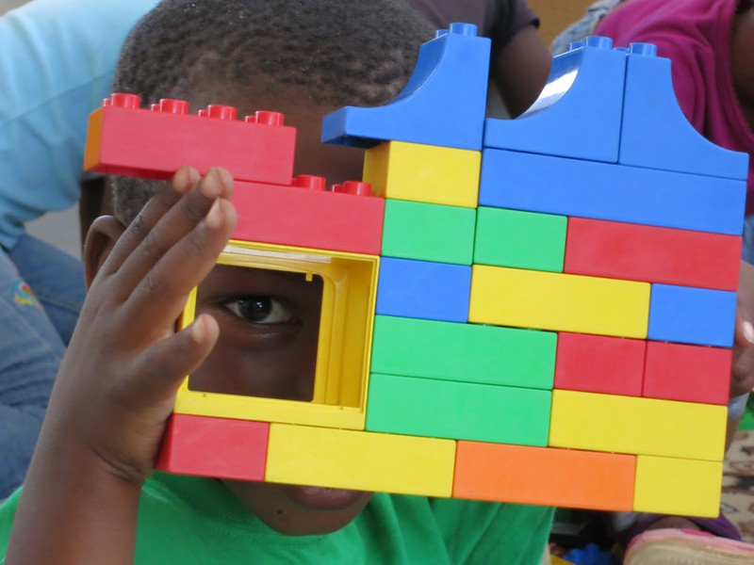
Block Center (p.19)
What questions might we ask at each of the 6 Bloom’s levels?
What domain(s) and dimension(s) of CLASS are addressed?
How do the questions drive contingent responses?
Let’s walk through a center together
flickr.com/photos/cusd/8208379556

Slide 14
Block Center
flickr.com/photos/cusd/8208379556
Bloom’s levels
6 – Create: Can you change this to make it have a flat roof?
5 – Evaluate: Would this design be a good home to live in?
4 – Analyze: Look at your friend’s creation. Which is taller?
3 – Apply: Why did you choose to add a window?
2 – Understand: Can you describe your building to me?
1 – Remember: Where is the red block in your design?

Slide 15
Block Center
flickr.com/photos/cusd/8208379556
CLASS connections
Contingent conversation
4 – Analyze: Look at your friend’s creation. Which is taller?
You’re right! How do you know? What strategy did you use?
Did you compare them? Compare means…
What did you use to measure the legos? That’s called a ruler.
What number does your building reach on the ruler? Let’s put the bottom edge of the ruler at the bottom of your building. Let’s slide our finger up to where your building stops and find the closest number.
5. That’s right. 5! What about your friends’ building? Which number is larger?
If I added THIS piece, what would happen?

Slide 16
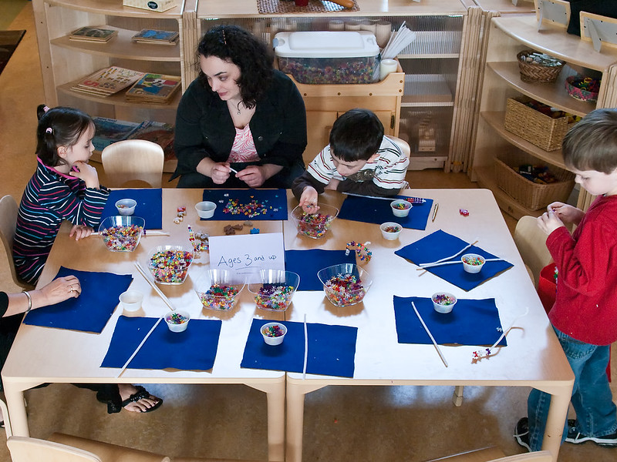
Math Manipulatives (p.25)
POLL
Which of these questions might you ask in this center if you wanted to target level 4 or higher (analyze, evaluate, create)?
“Can you find blue beads?”
“What colors are in this pattern?”
“Which beads do we need to add to this AB pattern?”
flickr.com/photos/aboyandhisbike/4471626674
Notes:
ANSWER: “Which beads do we need to add to this AB pattern?”

Slide 17
Math Manipulatives (p.25)
POLL
Which statement is mapping their actions with language?
“Oh, I see you’re using pink, green, yellow. You’re building a pattern on your string of pink… green… and yellow.”
“That’s a tricky pattern!”
“Please keep the beads on the table.”
flickr.com/photos/aboyandhisbike/4471626674
Notes:
ANSWER:
“Oh, I see you’re using pink, green, yellow. You’re building a pattern on your string of pink… green… and yellow.”

Slide 18
Math Manipulatives (p.25)
CHAT
If a student struggled with understanding how to extend an AB pattern, how could we move to a different Bloom’s level to build understanding?
Please use the chat box. ☺
flickr.com/photos/aboyandhisbike/4471626674
Notes:
ANSWERS:
“What colors are in this pattern?” Take the step back to make sure the child can identify the pattern first. Then you can move forward.

Slide 19
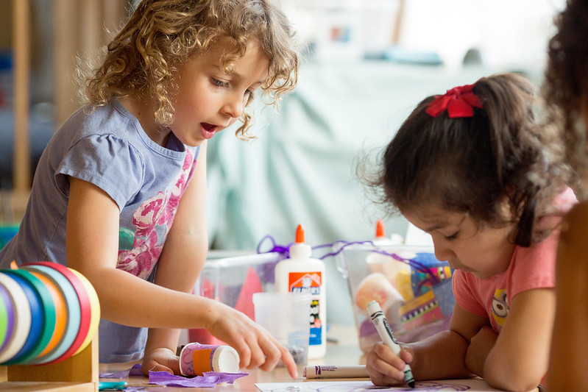
Makerspace in the Science Area (p.31)
POLL
Which question might you ask in this center to build a tentative child’s confidence in this center – and to begin contingent conversation?
“What might you build to catch a leprechaun?”
“Can you tell me what you are making?”
“What are the rules for using the glue?”
flickr.com/photos/all4ed/35668269904
Notes:
ANSWER:
“Can you tell me what you are making?”

Slide 20
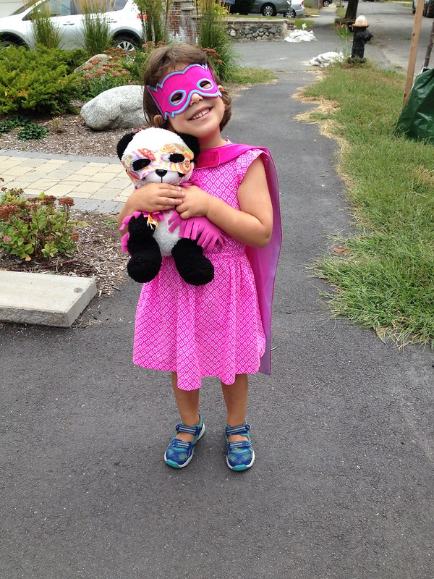
Dramatic Play (p.13)
What color is your cape?
Pink.
Are you a super hero?
Yes.
Cool! Good job! I like pink super heroes.
How could we make this exchange a better example of contingent responding that advances the child’s thinking?
flickr.com/photos/unnormalized/21205762549

Slide 21
Ooh! I see something that you and your panda have in common. Do you know what it is?
We are friends.
I bet you are friends, but I notice something about your costumes.
We both have masks.
That’s right! You both have masks. Do you have super powers, too?
We can both run really fast.
Being fast is a great superpower to help people. Since work time is ending soon, would you like to help me clean up our dramatic play center?
Yes. I can help.
That’s so kind of you. Thank you.
Dramatic Play (p.13)
flickr.com/photos/unnormalized/21205762549

Slide 22
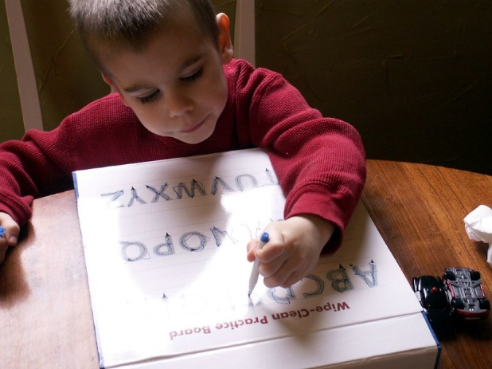
Writing (p. 37) and Art (p.43)
flickr.com/photos/all4ed/35668261674/
CHAT
https://flickr.com/photos/chrisandjenni/431074917
“How has your writing changed since the last time you practiced your letters?”
“What happens when you press really hard on the paper with your crayon? What about when you press softly?”

Slide 23
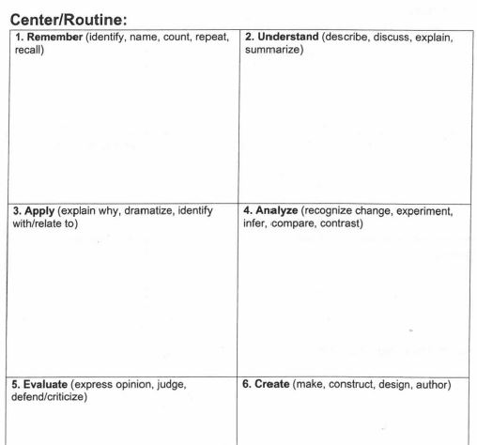
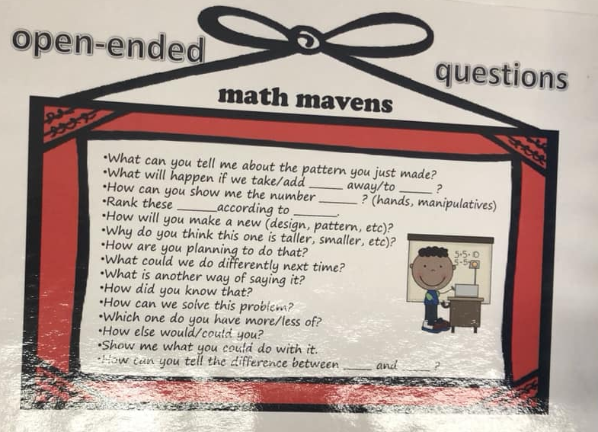
Practical Suggestions
Write key questions ahead of time (Thanks, Fairfax, for handout)
Contingent conversations may take practice. Try and keep at it.
Post question stems near centers so volunteers, aide, visitors can promote language (Thanks, Norfolk, for question stems)
Notes:
So let’s wind things down with some practical suggestions for implementing the use of Big Questions in Learning Centers.
First, write out key questions ahead of time. This may not come naturally to everyone – or to anyone – at first try, so plan for it. Fairfax developed a handout that may help you plan your questions at each Bloom level for your learning centers. We’ll send this out after the webinar.
Second, even once you plan for it, it still takes intention and practice. Keep at it. Perhaps even record yourself attempting contingent conversation with a child. Listen, check your bloom levels, and see if you’re giving wait time, including the child’s experiences, and matching their interest, development, etc.
Third, consider posting some question stems near centers so you can maximize language rich interactions. This would enable teachers, instructional aides, volunteers, visitors, even grade-school buddies to help promote conversation! I loved seeing this in a Norfolk classroom at each learning center. I felt very equipped to jump in and talk to kids!

Slide 24
For Next Session:
Develop list of questions at all levels for one (or more) center(s). See handout.
Practice contingent conversation and serve-and-return using your prompting questions in learning centers.
Share how it goes at our next webinar.

Slide 25
Coming soon to the Advancing Effective Interactions and Instruction in VPI Classrooms website:
https://curry.virginia.edu/faculty-research/centers-labs-projects/castl/advancing-effective-interactions-instruction-vpi
VPI-for-30 recorded webinar links, handouts, and slide decks
Certificates of webinar attendance will be sent to school division VPI Coordinators.
Next VPI-for-30 Webinar
Thursday, January 23, 2020 @4pm
Asking Children Big Questions Anytime, Anywhere - Part 2

Slide 26
Contact Information
Laura.Kassner@doe.virginia.gov
www.doe.virginia.gov
Twitter: @VDOE_News Facebook: @VDOENews
#VAis4Learners #EdEquityVA

