Slide 1

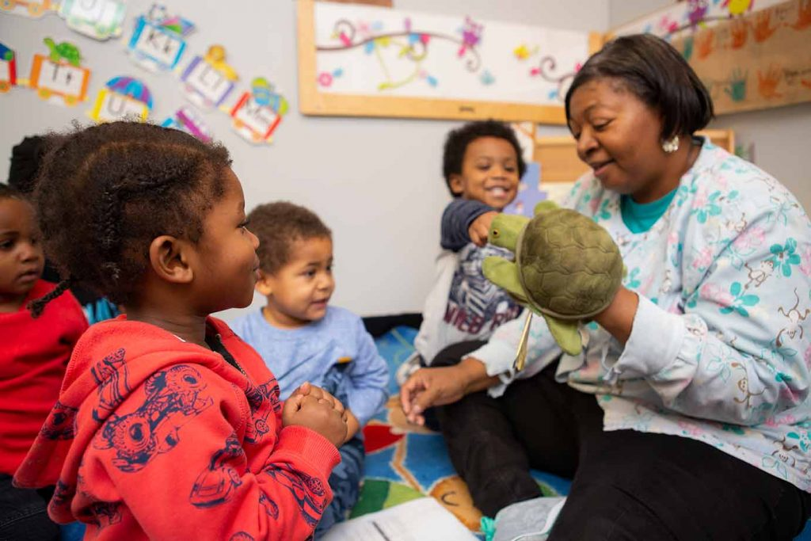
Thank you for joining us today!
Take a moment to respond to this question in the chat box….
Think Starter
"Think about a moment this week when you felt truly connected to a child—what did you do, and how did the child respond?"
Notes:
(3 min)
“Before we begin, I want you to take a breath and just arrive in this space. You’ve already done meaningful work today—and this time is for you.”
Give participants 60–90 seconds to reflect (read slide)
Then say: “Think about your tone, your body language, your words. What made that moment special?”
Invite 2–3 responses.
Affirm responses:
“That’s a powerful example of connection.”
“You noticed the child—that matters.”
Connection: “These small moments are actually the BIG moments in child development.” “Today, we’re going to take those meaningful moments and make them even more intentional.”

Slide 2
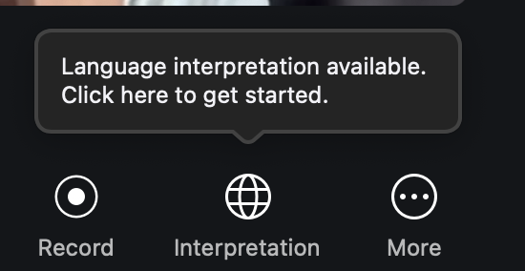
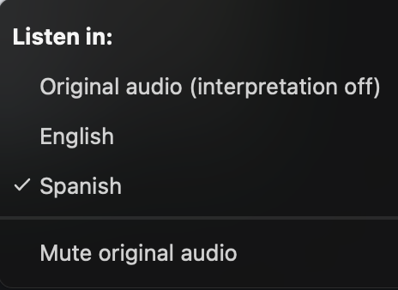
¡Bienvenido! Escuchar en Español
Desde Ordenador (Computer)
En los controles de su reunión web, haga clic en Interpretation (Interpretación).
  In your meeting/webinar controls, click Interpretation.
Haga clic en Español.
  Click Spanish.
Para escuchar solo el idioma interpretado, haga clic en Mute Original Audio (Silenciar audio original).
  To hear the interpreted language only, click Mute Original Audio.
Notas: Debe unirse al audio de la reunión a través del audio/VoIP de su computadora. No puede escuchar la interpretación de un idioma si usa las funciones de audio de marcación o llamada telefónica.
  Notes: You must join the meeting audio through your computer audio/VoIP. You cannot listen to language interpretation if you use the dial-in or call me phone audio features.
Por Teléfono (Phone)
En los controles de reunión, haga clic en los puntos suspensivos.
  In your meeting controls, tap the ellipses.
Toque Language interpretation (Interpretación de idioma). Haga clic en Español.
  Tap Language Interpretation. Click Spanish.
Para escuchar solo el idioma interpretado, toque el botón para silenciar el audio original
  Tap the toggle to Mute Original Audio.
Haga clic en Done (Listo).
  Click Done.
Notes:
(1 min)
(Pause for the interpreter to explain instructions)
We want today’s conversation to be accessible to everyone, so here are quick reminders about our Spanish interpretation options.

Slide 3
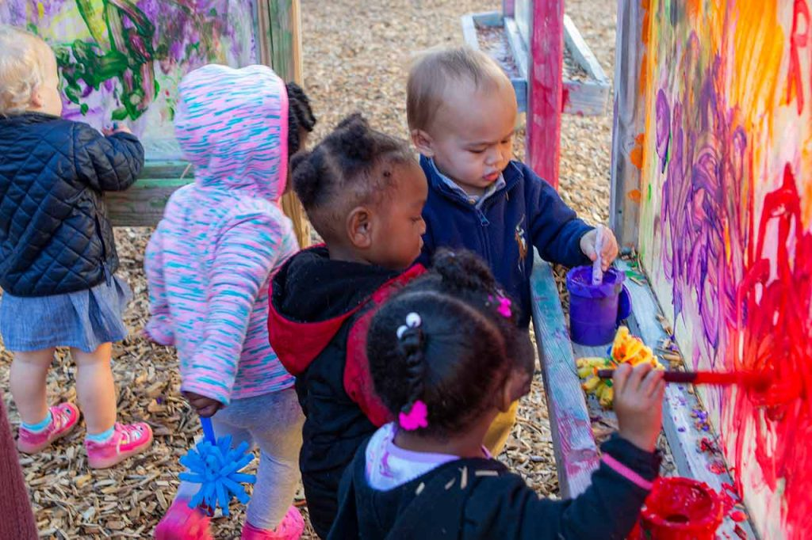
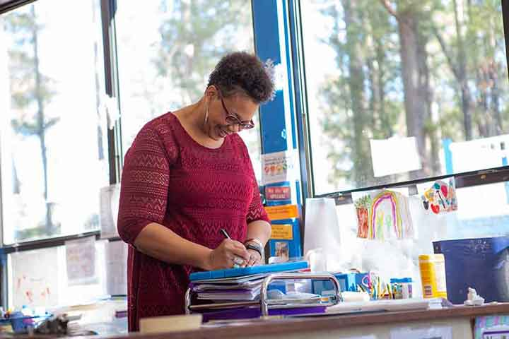
From Observation to Transformation: Using Video Reflection to Strengthen Teacher-Child Interactions & Reflective Practice
(Infants → Responsive Caregiving | Toddlers → Engaged Support for Learning | Pre-K → Instructional Support)
May 7, 2026 @1pm
Dr. Tara L. Scott
Virginia Early Childhood Consultation (VECC)
Notes:
(1 min)
Welcome, everyone! I’m so glad you’re here. Today is about reflection, growth, and celebrating the meaningful work you do every single day. This is not about being perfect—it’s about being intentional.”
Set norms:
This is a safe space!
We focus on strengths first!
We grow together!

Slide 4
Session Objectives
Educators will:
Engage in data-informed reflection to identify strengths and areas for growth
Reflect on real classroom videos & scenarios to identify effective teacher-child
interactions
Strengthen CLASS-aligned practices across Infant, Toddler, and Pre-K settings
Create a simple, actionable plan to improve daily interactions
Notes:
(1 min)
“Keep these objectives in mind—but don’t feel like you have to do everything.
If you leave today with one idea, one shift, one strategy, that’s success.”
“Let’s take a moment to ground ourselves in what we are hoping to accomplish today.”
Go through each objective with clarity and purpose:
Reflect on real classroom videos
“We are going to watch real classroom moments—not perfect ones, but authentic ones. The goal is to slow down our thinking and notice what is happening in interactions.”
Strengthen CLASS-aligned practices
“This connects directly to CLASS—not as a tool to measure, but as a guide to strengthen what we already do. We’ll look across infants, toddlers, and Pre-K to see how interactions grow over time.”
Apply intentional strategies
“This is not about adding more to your day—it’s about being more intentional in the moments that already exist, like play, routines, and conversations.”
Engage in data-informed reflection
“We will briefly think about what data tells us—where educators are strong and where growth is possible. This helps us focus our energy in meaningful ways.”
Create an actionable plan
“By the end, you will walk away with one small, realistic step you can try tomorrow. Small changes in interactions can make a big difference.”
“Everything we do today is meant to support you—not evaluate you. You are already doing powerful work, and today we’re building on that.

Slide 5

Build Your Toolkit From This Session
CLASS Practices/Scenarios/Videos
Action Plan
Ready-to-Use Resources
Short Survey
1 hr. Certificate
Notes:
(1 min)
“Everything we share today is meant to be practical—not just something you hear, but something you can use immediately.”

Slide 6
Why Teacher-Child Interactions Matter
Resources to Support Your CLASS Journey
Teachstone: Infant Exemplar Video: Early Language Support
Teachstone: Using CLASS with ALL Children (video)
Teachstone: Teaching with CLASS (varied list of podcasts)
ECE Resource Hub (UVA-CASTL): Strategy Library
Teachstone: CLASS Support Resources for Teachers
(NCPMI): **Using Function-Informed Support to Address Challenging Behaviors within Routines
(T/TAC): **Understanding Autism: A Little Perspective
UVA-CASTL: CLASS® Tool Summaries:
Infant /Spanish Toddler/ Spanish Pre-K/Spanish
Thinking across all age groups……
Relationships build brains
Interactions = learning
Small moments matter
Notes:
(2 mins)
“Let me ask you—how many interactions do you think you have with children in a single day?”
(Pause)
“Hundreds.”
“And each one is shaping development.
“Children learn through relationships.”
Examples:
A smile builds trust
A question builds thinking
A response builds security
Key message: “Every interaction is shaping how a child feels, thinks, and learns.”
****Educators requested these resources during previous webinars!

Slide 7
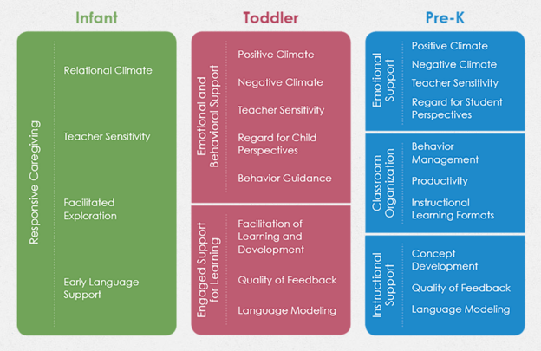
CLASS Across the Ages
Notes:
(1 min)
Take a look at the chart to see how the CLASS tool is broken up at the first three age levels—from a single domain at the infant level, to the three domains in pre-K classrooms.
CLASS reminds us that how we interact matters just as much as what we teach. “It’s not about doing different things—it’s about doing the same things more deeply.”

Slide 8
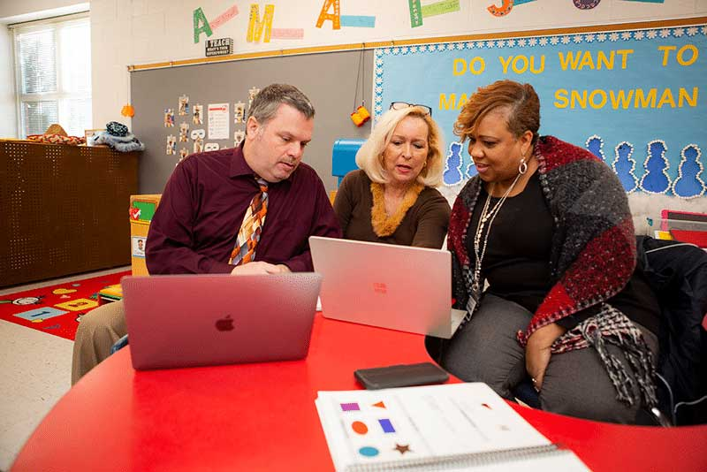
What We’re Noticing in the Data
Data are pulled from VDOE’s publicly available data of VQB5 CLASS® Data Averages from 2024-25
Notes:
(1 min)
Reflect on your current CLASS Observation Scores. First, review your dimensions of strength. Now, think about your targeted CLASS Dimensions to grow. “Let’s look at this data not as numbers—but as a story.”

Slide 9
What Do the CLASS Numbers Mean?
CLASS® Ranges (scores) | What it means
Low range (1-2) | Observed rarely, at a lower quality
Mid range (3-5) | Observed sometimes, varying quality, with some children
High range (6-7) | Observed consistently, high quality, across children
Notes:
(1 min)
“These CLASS numbers help us see trends, not judgments. They tell us where children need more support and where teachers can use more tools.
Think of CLASS as a mirror — not a report card. Today’s strategies help bring those numbers to life in your everyday interactions.”
CLASS® scores range from 1 to 7, showing how often and how well effective interactions are observed in classrooms.
A score in the Low Range (1–2) means the behavior or interaction is observed rarely and at a lower quality — it might happen occasionally but not in a meaningful or consistent way.
A Mid Range (3–5) score shows the behavior is seen sometimes and with varying quality — teachers demonstrate it with some children or during certain moments, but not consistently.
The High Range (6–7) reflects consistent, high-quality interactions across children and throughout the observation — this is where strong, intentional teaching and caregiving are most visible.
Here is a reminder: CLASS® scores don’t measure perfection—they show patterns of interactions and help identify where coaching and support can make the greatest impact.

Slide 10
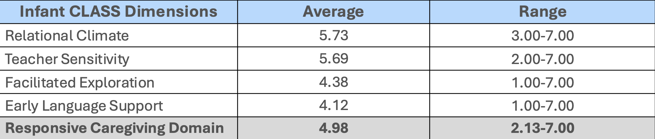
What We’re Learning About Infant Interactions in Virginia
Data are pulled from VDOE’s publicly-available data of VQB5 CLASS® Data Averages from 2024-25
Notes:
(1 min)

Slide 11
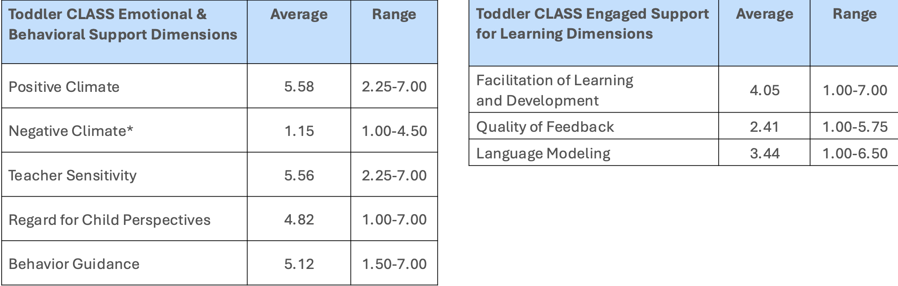
What We’re Learning About Toddler Interactions in Virginia
Toddler Total CLASS Score 4.73 2.22-6.63
Data are pulled from VDOE’s publicly-available data of VQB5 CLASS® Data Averages from 2024-25
Notes:
(1 min)

Slide 12
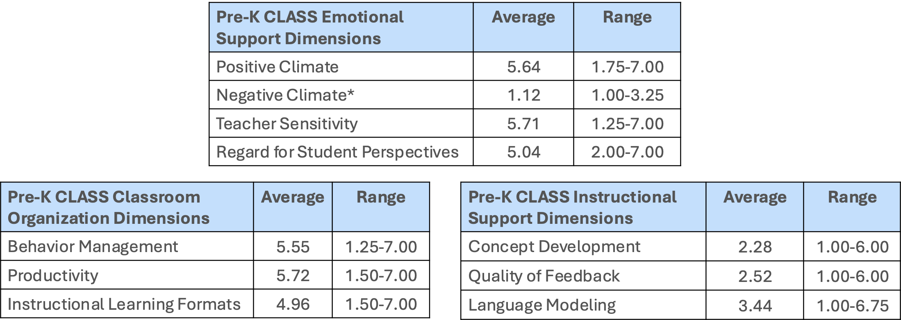
What We’re Learning About PreK Interactions in Virginia
Pre-K Total CLASS Score 4.78 1.90-6.60
Pre-K Total CLASS Score 4.78 1.90-6.60
Data are pulled from VDOE’s publicly-available data of VQB5 CLASS® Data Averages from 2024-25
Notes:
(1 min)

Slide 13

Data Reflection Question
Where do you see strengths in your interactions?
(Think about your daily routines)
Notes:
1 min
“Let’s ground this in your reality.”
“Where do you already feel confident?” (Launch Poll)
“Across classrooms, we see something consistent…”
Strengths:
Teachers are caring.
Classrooms are structured.
Growth areas:
Extending conversations
Asking deeper questions
Providing feedback loops

Slide 14
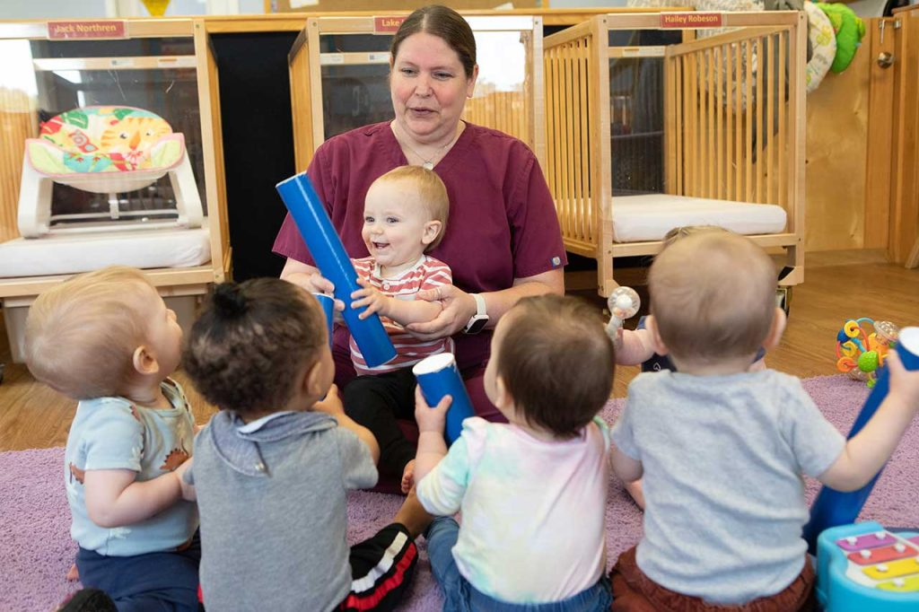
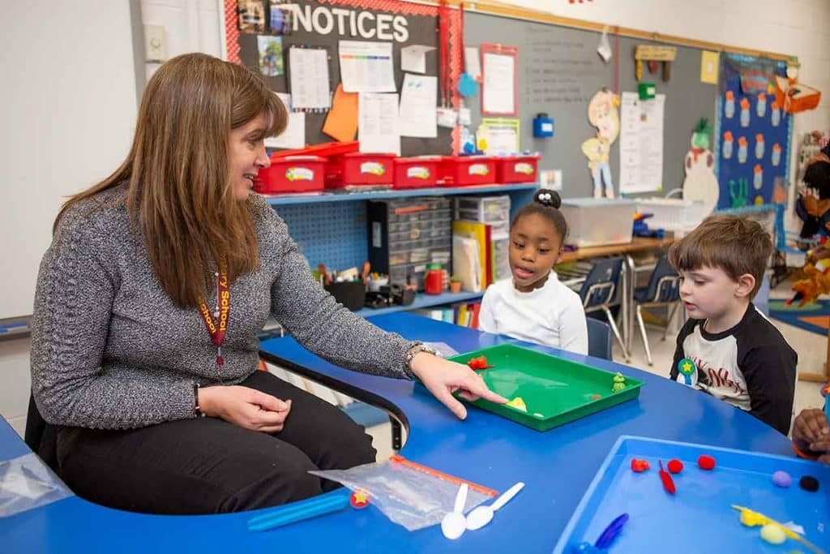

From Data to Practice: Bringing Interactions to Life Through Videos
Notes:
1 min
“This is where we shift from thinking… to seeing… to doing.” “Because data tells us what—but video shows us how.”
What is Video Reflection?
Watch
Notice
Reflect
Improve
“Video reflection allows us to slow down teaching.”
Key points:
You see what you might miss in the moment
You notice strengths
You identify next steps
Great benefit of video recording your own teaching practices (e.g., 10-20 min) to observe your areas of strengths and areas to grow---this can lead to action planning for PD and improving your teacher-child interactions.
We are not looking for what’s wrong—we are looking for what’s working and how to build on it.

Slide 15
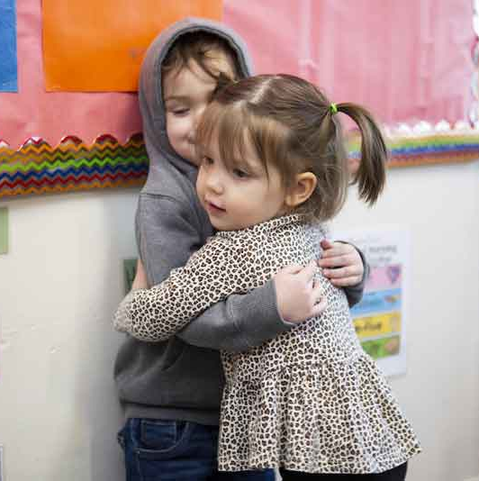
Infants
Notes:
(1 min)
“Infants need consistent, responsive relationships.”
Awareness and Cue Detection- (visually scanning the classroom, physically turning to the infants, acknowledging verbally and physically
Responsiveness – Responding to infants’ emotions and needs and adjusting actions based on their needs
Infant Comfort – Infants appear content in the classroom and comfortable with teachers; infants seek teachers for help; infants are soothed or calmed by teachers’ efforts
“Every time you respond, you are telling a child: You matter. I see you. I hear you.’”

Slide 16
Infants – Looking Closer
Domain: Responsive Caregiving (RC)
Dimension: Teacher Sensitivity (TS)
Indicators:
Awareness and Cue Detection
Responsiveness
Infant Comfort
Notes:
(1 min)
“Infants need consistent, responsive relationships.”
Awareness and Cue Detection- (visually scanning the classroom, physically turning to the infants, acknowledging verbally and physically
Responsiveness – Responding to infants’ emotions and needs and adjusting actions based on their needs
Infant Comfort – Infants appear content in the classroom and comfortable with teachers; infants seek teachers for help; infants are soothed or calmed by teachers’ efforts
“Every time you respond, you are telling a child: You matter. I see you. I hear you.’”

Slide 17
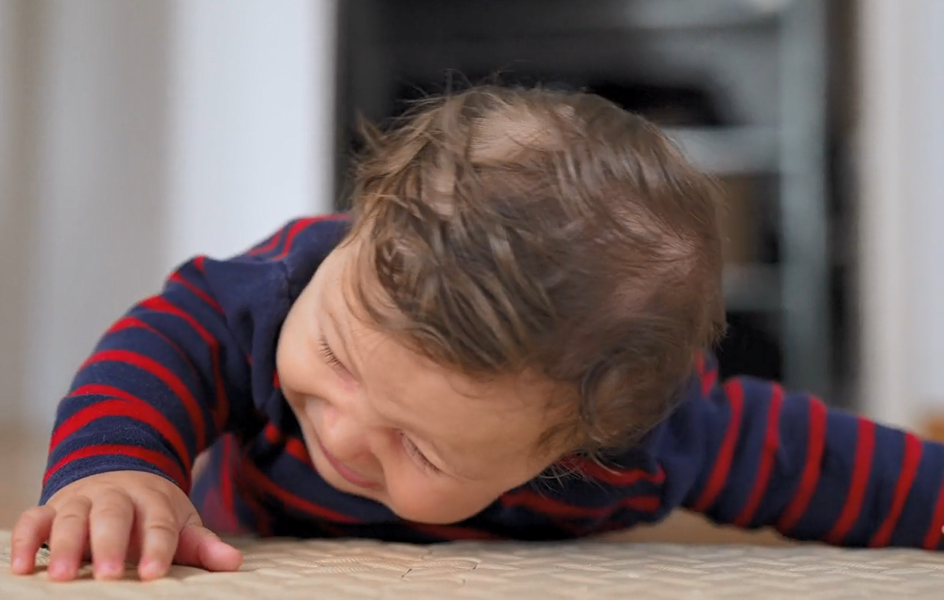
Infant Scenario
Baby is fussing during tummy time.
CLASS Practices:
Get on the infant’s eye level
Use a calm voice
Acknowledge infants’ emotions
Notes:
(2 min)
“Let’s bring this to life.” “What would this sound like in your classroom?”
(Read scenario)
“I see you’re working hard… I’m right here.”
Explain:
Narration builds language
Presence builds trust
(Read the CLASS Practices). Think about which practices are consistent in your classroom. Identify the ones you need to grow (go ahead, write it down)

Slide 18
More About Infants
Awareness and Cue Detection - consistently aware of the infants; continues monitoring the other infants by turning her head or visually scanning the room.
Responsiveness- The teacher consistently responds to infants’ cues in a timely manner and adjusts her actions based on their needs.
For example, when Lila cries, she asks her, “What’s the matter?”
Notes:
(4 min)
No video just talking points:
Awareness and Cue Detection • The lead teacher is consistently aware of the infants sitting around her. She physically attends to the infants by orienting herself toward them, and, though she may direct her attention to one infant at a time, she continues monitoring the other infants by turning her head or visually scanning the room. • The lead teacher notices the infants’ cues and bids for attention, such as when Abby knocks over her toy piano (“You having trouble, Abby?
Responsiveness • The lead teacher consistently responds in a timely manner to the cues of the infants and adjusts her actions based on their needs. For example, when Lila cries, she asks her, “What’s the matter?”
Infant Comfort • The infants appear content and comfortable with the lead teacher. The infants play on the rug around the lead teacher, Emmett, who allows her to tickle him, and Lila smiles when the teacher puts her in her seat.
What will you try in your classroom?

Slide 19
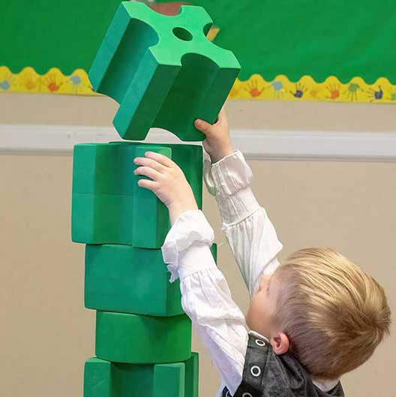
Toddlers
Notes:
2 min.
“Toddler learning is messy—and that’s a good thing.” “Our job is to guide thinking.”
Scaffolding (Helping Without Taking Over)
What it means:
The teacher supports a child’s learning by giving just enough help so the child can keep going—without doing it for them.
What it looks like:
Breaking a task into smaller steps
Giving a hint or starting point
Asking guiding questions
Example:
Instead of: “Here, let me do it.”
Try: “You started it—what could you try next?”
Key idea: Support children to figure it out, not just get the answer.
Providing Information (Explaining & Expanding Learning)
What it means:
The teacher adds information to help children understand what they are doing, seeing, or learning.
What it looks like:
Naming objects, colors, or actions
Explaining how something works
Connecting to what the child is doing
Example:
Instead of: “That’s blue.”
Try: “That’s a blue block—it’s the same color as your shirt!”
Key idea: Help children learn more about the world through your words.
Encouragement & Affirmation (Clear--to the point meaningful feedback)
What it means:
The teacher notices children’s efforts and gives feedback that tells them what they did well and why it matters.
What it looks like:
Describing effort or strategy
Highlighting persistence
Giving specific praise
Example:
Instead of: “Good job!”
Try: “You kept trying until it worked—that shows great problem-solving!”
Key idea: Help children understand what they did and build confidence.

Slide 20
Toddlers – Looking Closer
Domains: Engaged Support for Learning (ESL)
Dimension: Quality of Feedback (QF)
Indicators:
Scaffolding
Providing Information
Encouragement and Affirmations
Notes:
2 min.
“Toddler learning is messy—and that’s a good thing.” “Our job is to guide thinking.”
Scaffolding (Helping Without Taking Over)
What it means:
The teacher supports a child’s learning by giving just enough help so the child can keep going—without doing it for them.
What it looks like:
Breaking a task into smaller steps
Giving a hint or starting point
Asking guiding questions
Example:
Instead of: “Here, let me do it.”
Try: “You started it—what could you try next?”
Key idea: Support children to figure it out, not just get the answer.
Providing Information (Explaining & Expanding Learning)
What it means:
The teacher adds information to help children understand what they are doing, seeing, or learning.
What it looks like:
Naming objects, colors, or actions
Explaining how something works
Connecting to what the child is doing
Example:
Instead of: “That’s blue.”
Try: “That’s a blue block—it’s the same color as your shirt!”
Key idea: Help children learn more about the world through your words.
Encouragement & Affirmation (Clear--to the point meaningful feedback)
What it means:
The teacher notices children’s efforts and gives feedback that tells them what they did well and why it matters.
What it looks like:
Describing effort or strategy
Highlighting persistence
Giving specific praise
Example:
Instead of: “Good job!”
Try: “You kept trying until it worked—that shows great problem-solving!”
Key idea: Help children understand what they did and build confidence.

Slide 21
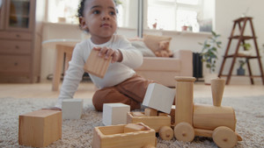
Toddler Scenario
Child struggling with blocks.
CLASS Practices
Ask open-ended questions
Offer hints
Celebrate efforts (acknowledge toddlers’ persistence in a task)
Notes:
1 min.

Slide 22
Toddler Video
Video: Providing Information with Pretend Play
What is the teacher doing to keep the learning going?
Notes:
(4 min)
In this toddler classroom, the teacher provides hints, assistance, and information to help the children succeed in building with different hands-on materials.
Scaffolding ● The teacher assists a child making a chain with toy elephants. The teacher says, “There’s your purple one. I started it off for you so now you can hook another one in. How do you hook it in?”
Providing Information ● The teacher provides clarification to a child participating in the hands-on activity of making a chain with toy elephants by saying, “This is a blue.”
Encouragement and Affirmation ● The teacher recognizes the children’s efforts and offers specific feedback by saying, “Good job, that’s the way you hook it in,” and “Let’s see how tall you can build.”

Slide 23
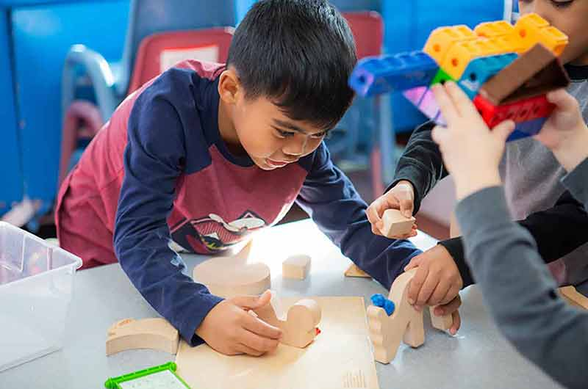
PreK
Notes:
(2 min)
(Read slide)

Slide 24
PreK – Looking Closer
Domain: Instructional Support (IS)
Dimensions: Language Modeling (LM) & Concept Development (CD)
Language Modeling Indicators:
Frequent Conversation (Back-and-forth exchanges; peer conversations)
Open-ended Questions (“Why?; How?“)
Repetition and Extensions (repeats; extends)
Self-and-Parallel Talk (narrate actions)
Advanced Language (variety of words)
Concept Development Indicators:
Analysis and Reasoning (problem-solving, classification)
Creating (brainstorming, planning)
Integration (connecting activities to one another; integrating prior knowledge)
Connections to the Real World (related to children’s lives)
Notes:
(2 min)
(Read slide)

Slide 25
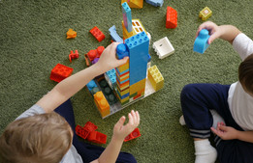
PreK Scenario
Children are building a bridge with blocks. It keeps falling.
CLASS Practices
Ask open-ended questions
(“How & Why”)
Predict
Reflect
Notes:
(1 min)
“You noticed it keeps falling—what do you think is making it unstable?”
The teacher can deepen thinking by asking:
“Why do you think it keeps falling?” (cause and effect)
“What could we try differently?” (problem-solving)
“What do you predict will happen if we use smaller blocks?” (prediction)

Slide 26
PreK Video
Video: Center Time Talk about Tools
Think about what CLASS strategies you will try in your classroom.
Notes:
(4 min)
During center time, the teacher engages a few students in an extended conversation about making shapes with pretend tools.
After Video:
Frequent Conversation -The teacher talks regularly with the students in the dramatic play area and maintains back-and-forth exchanges by asking additional questions related to the students’ responses.
Open-Ended Questions - The teacher asks many open-ended questions. She asks a student who is playing with tools, “What are you building?” She then asks him, “Why are you cutting a rectangle?”
Repetition and Extension -The teacher acknowledges the student’s comments by repeating some of the words they use in their conversation
Self- and Parallel Talk - The teacher provides language for some of the students’ actions when she says, “Look at you sharing; you’re sharing those tools.”

Slide 27
Connecting Across Ages
Infants: Respond
Toddlers: Engage
Pre-K: Extend
Notes:
(1 min)
“Let’s bring it all together.” Same goal—different levels.
Explain progression clearly.
“Infants → we RESPOND.”
“Toddlers → we ENGAGE.”
“Pre-K → we EXTEND.”
“But the heart of it all… is connection.”

Slide 28
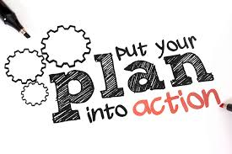
Action Planning
(Spanish)
What’s one CLASS strategy you’ll focus on next week?
Create a goal
How can you achieve this goal?
  Implementation steps
  Resources
Be consistent with positive interactions
Notes:
(3 min)
Drop action plan in chat box:
Let’s pause here! It’s time to reflect on your current CLASS data. What’s one CLASS strategy you’ll focus on next week? (asking open-ended questions, self-and parallel talk, being more responsive to the children’s needs, using more encouragement and affirmations, getting on the child’s level, or having back-and-forth exchanges)
Interactions shape children’s learning and development
Small, intentional moments make a big difference
Reflection helps us grow and refine our practice, which looks different across
ages—but the purpose stays

Slide 29

Thank you!
From Observation to Transformation: Using Video Reflection to Strengthen Teacher-Child Interactions & Reflective Practice
Please take 3 minutes to share your feedback in the Exit Survey
Plus, we’ll send you:
Slides with resources, and recording within 2 days
You’ll receive a certificate of when you complete the survey

