Slide 1
Asking Children Big Questions – Anytime, Anywhere (Part 2)
Authors Janis Strasser & Lisa Bresson
#4 of a 4-part Webinar Series
January 23, 2020
Notes:
MARK
This webinar series is based on the book Big Questions for Young Minds.
Today in particular, we ways to use big questions to maximize language development during other parts of the daily routine, covered in Chapters 7-12.

Slide 2
Today’s Presenter
Tamilah Richardson, Ed.D.
Virginia Department of Education
Associate Director, Early Childhood Learning
Tamilah.Richardson@doe.virginia.gov
Presented with support from the Fairfax County Early Childhood.

Slide 3
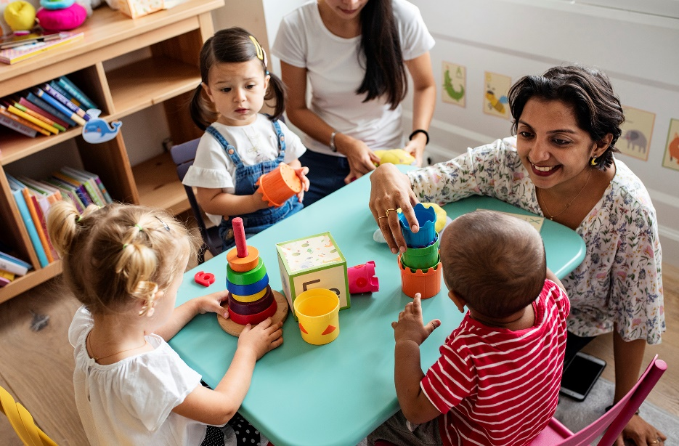
Effective, engaging interactions serve as the foundation for learning in early childhood classrooms.
Measuring teacher-child interactions consistently and using them to provide feedback to teachers lies at the heart of high-quality early childhood instruction.

Slide 4
Recap
Webinar #1: CLASS connection; closed versus open-ended questions
Webinar #2: questioning technique; serve and return
Webinar #3: contingent conversations; asking BQ in learning centers; Bloom’s & CLASS

Slide 5
Today’s Objective
Tie together our learning from across webinars and introduce more relevant research
Reflect on our practice
Continue to sharpen our skills in asking our children BIG questions!

Slide 6
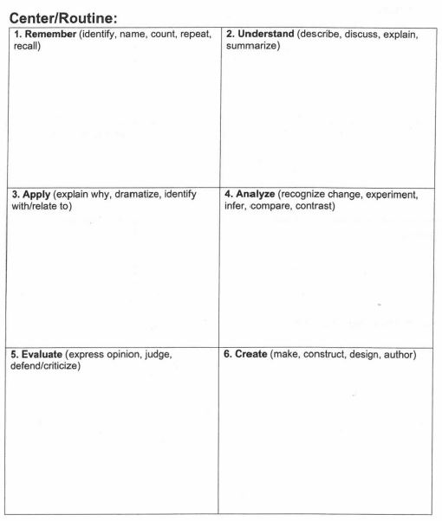
Practical Suggestions
Write key questions ahead of time (Fairfax handout)
Practice engaging in contingent conversations.
Post question stems near centers so volunteers, aide, visitors can promote language (Norfolk Show + Tell)
How did it go? Tell us in the chat box ☺

Slide 7
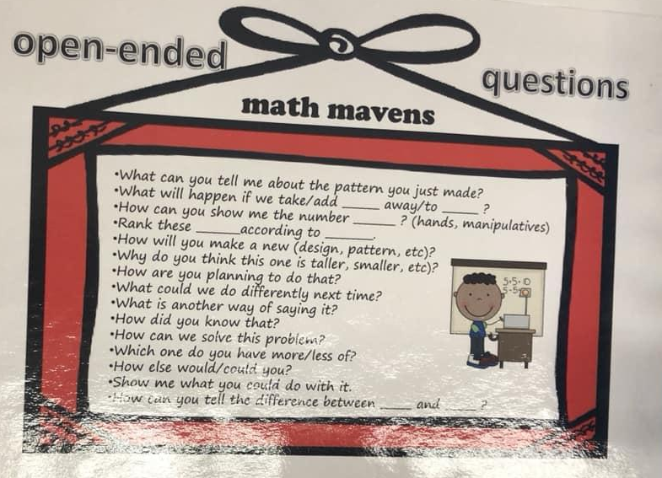
Practical Suggestions
Write key questions ahead of time (Fairfax handout)
Practice engaging in contingent conversations.
Post question stems near centers so volunteers, aide, visitors can promote language (Norfolk Show + Tell)
How did it go? Tell us in the chat box ☺

Slide 8
Every Minute Counts
5 min./day
25 min./week
900 min. (15 hrs.)/180 day SY

Slide 9
Ask Big Questions- Anytime, Anywhere!
etc…

Slide 10
CLASS Connection
Classroom Organization
Management of class time and attention to get the most learning out of every day
Efficient routines and transitions
Proactive behavior management
Active facilitation of learning

Slide 11
Big Questions for Young Minds
Part 2: Other Parts of the Daily Routine
Class Meetings
Read-Alouds
Outdoors
Mealtimes
Exploring and Making Music
Large Motor Activities
Authors Janis Strasser & Lisa Bresson

Slide 12
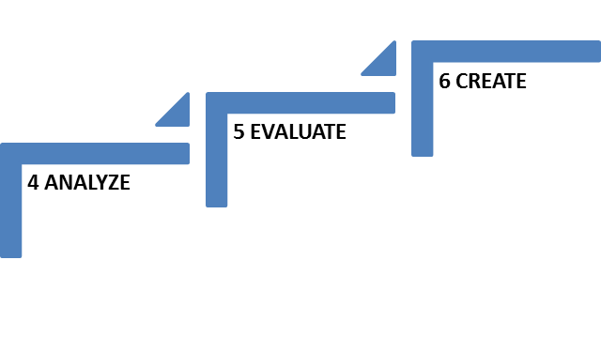
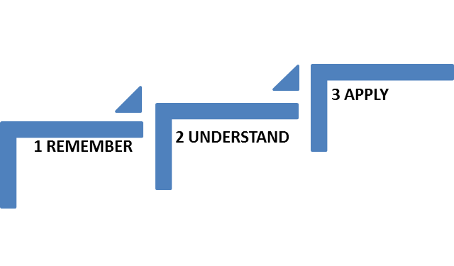
Chapter Organization for Young Minds
Vignette and why learning area matters
Getting started
Supporting children’s play and learning
Picture book ideas for each center
Starter questions for each Bloom level

Slide 13
Class Meetings- Chapter 7
Multi-purposed
Daily tasks
Problem-solving and creative collaboration
“Class meetings help create a safe environment for everyone. [They] can transform a group of individual children into a real community of learners.”
(Vance, 2014; as cited in BQYM, p. 51)

Slide 14
Core Skill Set for all VA Learners

Slide 15
High-Level Questions = High Yields
Builds a sense of community
Supports Social and Emotional Growth
Enhances Learning and Literacy

Slide 16
The Big Picture for VA’s Early Learners
44% of all Virginia’s kindergarteners are unprepared in one or more critical area- literacy, social skills, math, or self-regulation
56% Economically disadvantaged
66% identified as having a disability
Fall 2019 VKRP results

Slide 17
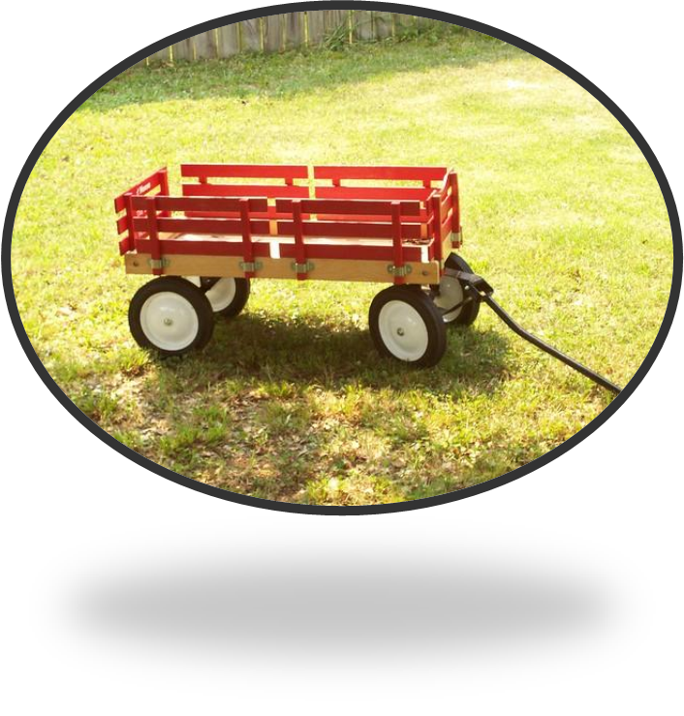
Class Meeting Framework
CHAT
Opening
Acknowledgements
Problem solving
Closing
(Vance, 2014)
When multiple children want control over who and when others should ride in the class wagon, what are some questions you might ask during a class meeting?

Slide 18
Social-Emotional Skill Building
Taught
Hard-wired
Taught
Humility
Forgiveness
Empathy
Optimism
Compassion
Sadness
Joy
Anger
Disgust
Surprise
Fear
Sympathy
Patience
Shame
Cooperation
Gratitude
“Emotional Keyboard”- Eric Jenson, Teaching with Poverty in Mind, 2009

Slide 19
Helpful Tips
Remember developmental appropriateness
5 min. to gradual buildup to 15 min.
Follow the children’s cues
Discuss problems that affect the group
*Allow choice
Practice active listening

Slide 20
Read-Alouds- Chapter 8

Slide 21
Let’s Practice!
3) Can you think of some ways our friends could fix their problem?
4) What do you think is the right thing to do? Why?
2)?
6 CREATE
5 EVALUATE
4 ANALYZE
2) What is a challenge?
1)What is the challenge our two turtle friends are facing?
3 APPLY
1 REMEMBER
2 UNDERSTAND
Authors Janis Strasser & Lisa Bresson
Based on Anderson, L.W., & D.R. Krathwohl, eds. 2000. A Taxonomy for Learning, Teaching, and Assessing: A Revision of Bloom’s Taxonomy of Education Objectives. New York: Pearson.

Slide 22
Outdoors- Chapter 11
Set the stage for learning
Provide tools for outdoor exploration
Make learning visible
Support inquiry through the use of informational resources (children’s literature, print and online resources)

Slide 23
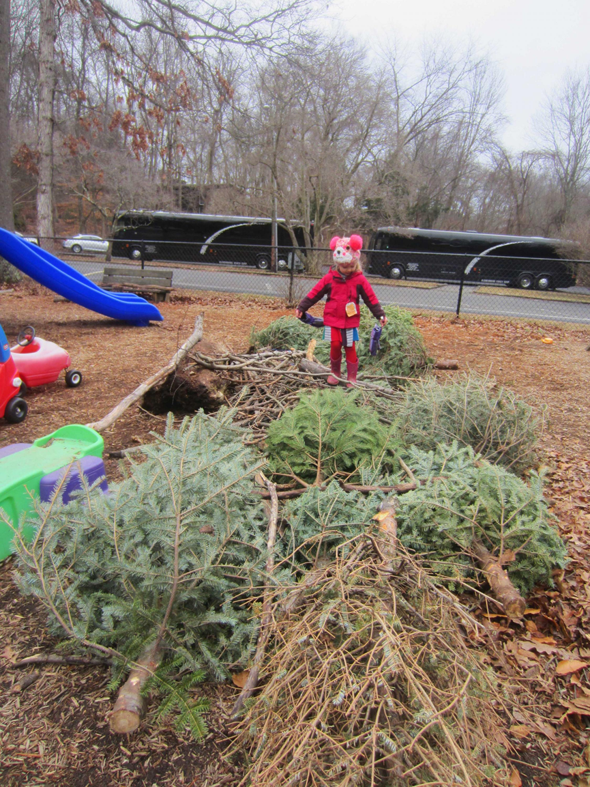
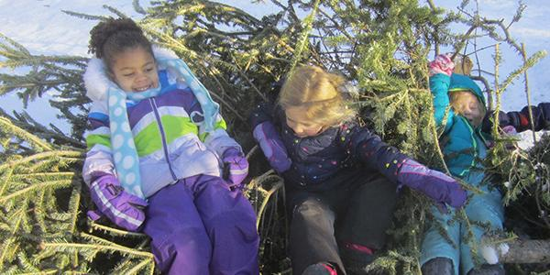
Transform Your Outdoor Spaces
New Year, New Use: Discarded Holiday Trees Transform the Playground
Teaching Young Children
December 2019/January 2020
Vol.12, No. 2

Slide 24
The Reggio-Emilia Approach
“Because…teachers and children’s minds meet on matters of real interest to both, teacher minds are also engaged. They seem intent on listening closely to the children’s suggestions and questions, probing their thinking, making suggestions, and encouraging children to respond to each others’ ideas.”
-Carolyn Edwards, Lella Gandini, George Forman (as cited in BQYM, p. 74)

Slide 25
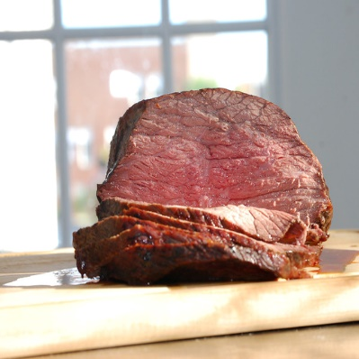
Mealtime- Chapter 12
Today is Thursday…
Thursday, roast beef…
All you hungry children, come and eat it up!
Practice serve and return and contingent conversations
Vary the level of questions asked
Take cues from the children
Ask about real-life experiences (family customs and traditions)
Help children problem solve
Keep it interesting!
Exemplar videos Teachstone library
For multi-lingual children: Talking about food is a concrete, relatable topic all children can relate to- so chat and chew away!

Slide 26
More in Store!
Part 3: More Learning Opportunities with Questions
Supporting Emotional Development During the First Months of School
Exploring Change Through Long-Term Studies
Supporting Children’s Understanding About Diversity
Part 4: Resources
For Teachers and Other ECE Providers
For Families
There’s a Question for That?
Anytime, Anywhere Questions
Reflection Questions

Slide 27
Practice Makes Permanent!
2)?
2)?
6 CREATE
5 EVALUATE
3)?
4 ANALYZE
1)?
3 APPLY
1 REMEMBER
2 UNDERSTAND
Authors Janis Strasser & Lisa Bresson
Based on Anderson, L.W., & D.R. Krathwohl, eds. 2000. A Taxonomy for Learning, Teaching, and Assessing: A Revision of Bloom’s Taxonomy of Education Objectives. New York: Pearson.

Slide 28
Coming soon to the Advancing Effective Interactions and Instruction in VPI Classrooms website:
https://curry.virginia.edu/faculty-research/centers-labs-projects/castl/advancing-effective-interactions-instruction-vpi
VPI-for-30 recorded webinar links, handouts, and slide decks
Certificates of webinar attendance will be sent to school division VPI Coordinators.
We hope you’ll join us for our next series of VPI-for-30 Webinars beginning in the Fall of 2020!

